Slide 1
Oracle APEX Overview
Enterprise application development for the AI era

Slide 2
Safe Harbor

Slide 3
Speaker

Slide 4
What is Oracle APEX?
Oracle APEX is trusted worldwide to deliver mission-critical, data-driven apps that are secure, scalable, and easy to build.
Oracle APEX is an enterprise AI application platform for building secure, scalable web and mobile applications.
Trusted by thousands of organizations, APEX powers systems that run core business operations every day.
With Oracle AI Database and Oracle Cloud Infrastructure, every application inherits built-in reliability, governance, and security.
APEX helps developers turn ideas into production-ready apps quickly, without sacrificing control or performance.

Slide 5
The Oracle APEX advantage
Use GenAI to rapidly build apps that meet business objectives
Focus on the intent of the app – not how to code it, and spend less time on maintenance going forward
Add AI to your apps
Add AI capabilities to apps even if you’re not an AI expert – giving users flexible options for using apps, and shortening their learning curve
Build enterprise-ready applications
Get the security, scalability, performance and reliability of Oracle Database
APEX is included with Oracle Database at no extra cost

Slide 6
Why APEX?
APEX brings application development, AI, workflow, integration, security, and data into one extensible platform running as part of Oracle Database.
Source
APEXlang, exports, version control, validation
Apps
Security
Web applications, responsive experiences, reporting
Oracle Database + APEX
Identity And Governance
SQL
PL/SQL
vectors
AI
transactions
metadata
sessions
AI Agents, Generate Text, AI Interactive Reports, vector search
security
Workflow
Tasks, Approvals, Audit
One application platform with a shared data, security, workflow, and runtime foundation.

Slide 7
Oracle APEX at a Glance
A complete enterprise application platform
AI-native patterns
AI reports, Generate Text, RAG, agents, vector search
Create apps
Data + logic
SDD, APEXlang, Assistant, App Builder
Oracle DB, SQL, PL/SQL, vectors, transactions
Oracle APEX
Enterprise AI App Platform
Govern
Integrate
Identity, sessions, APEXlang, lifecycle
REST, APIs, enterprise services
Operate
Workflow, reports, automation

Slide 8
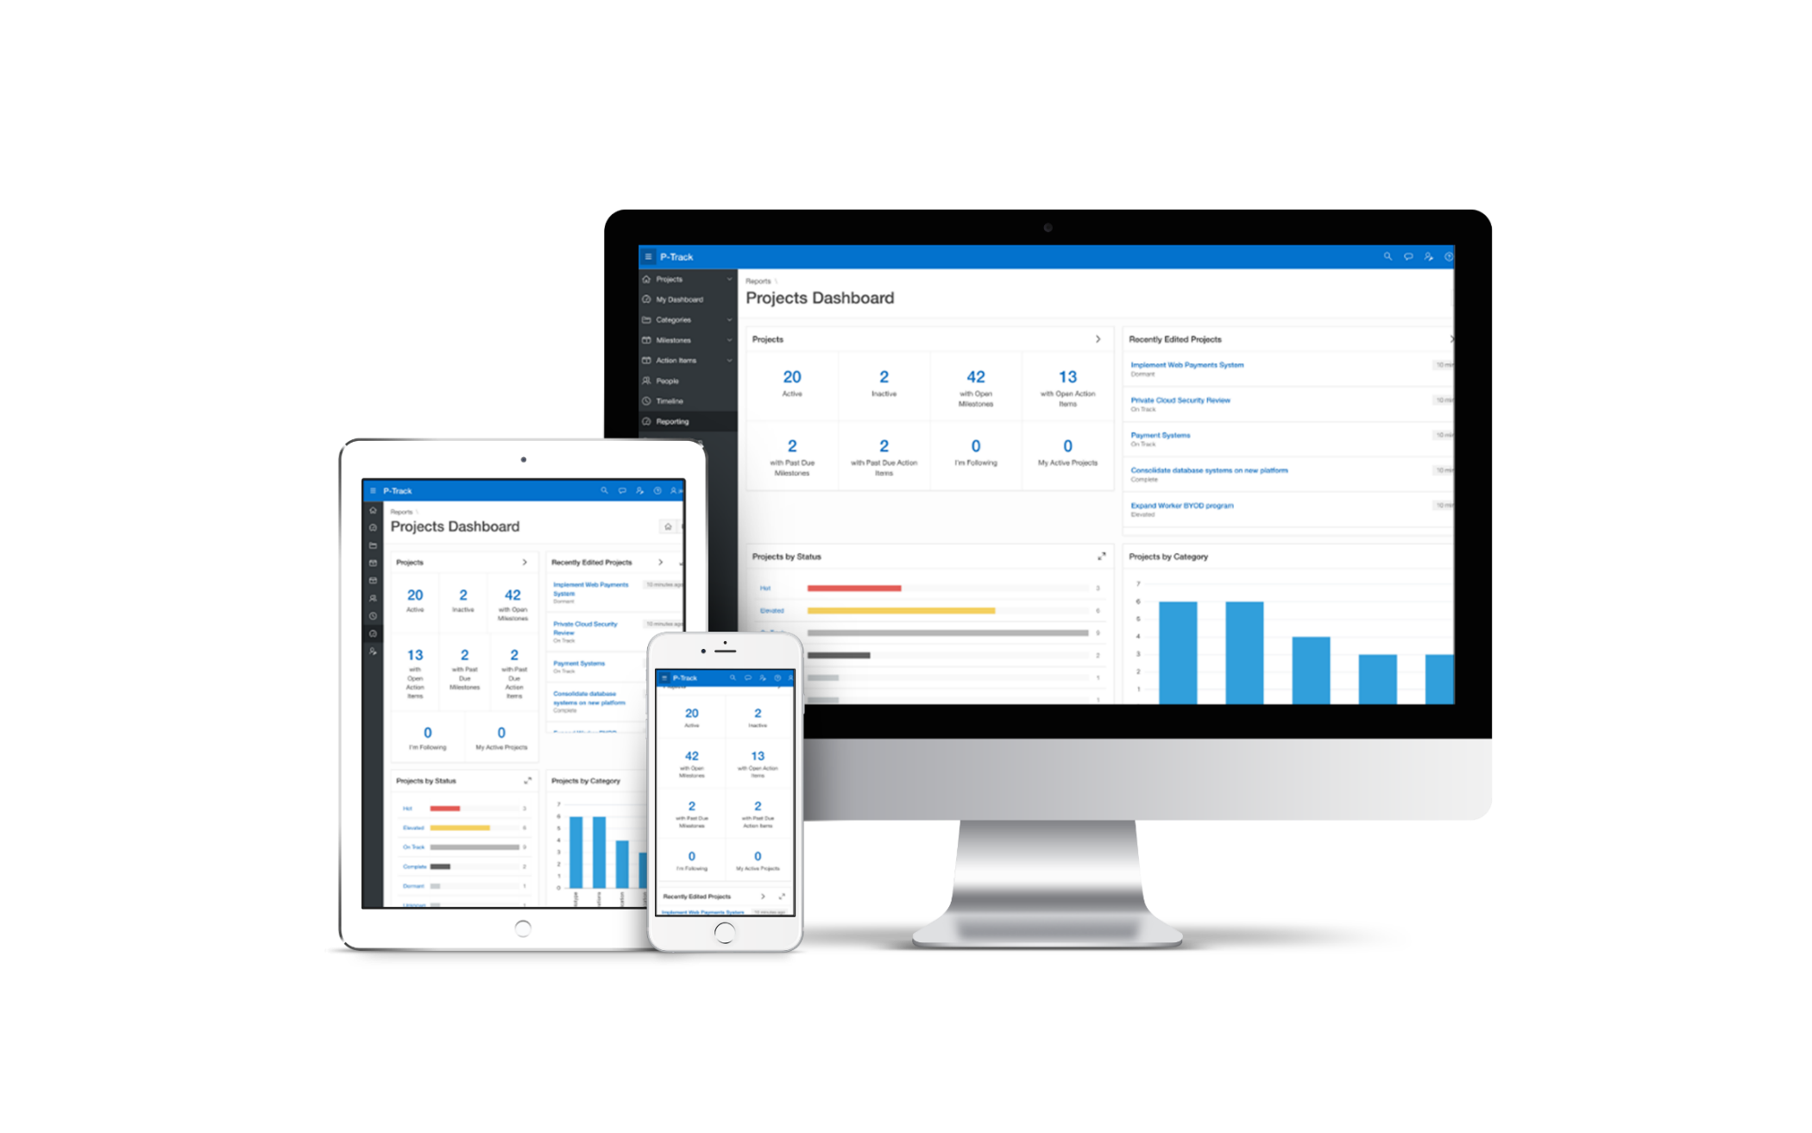
User Interface for Any Device
Modern, intuitive, accessible UI for any device
fully customizable and responsive apps
Learn more at apex.oracle.com

Slide 9


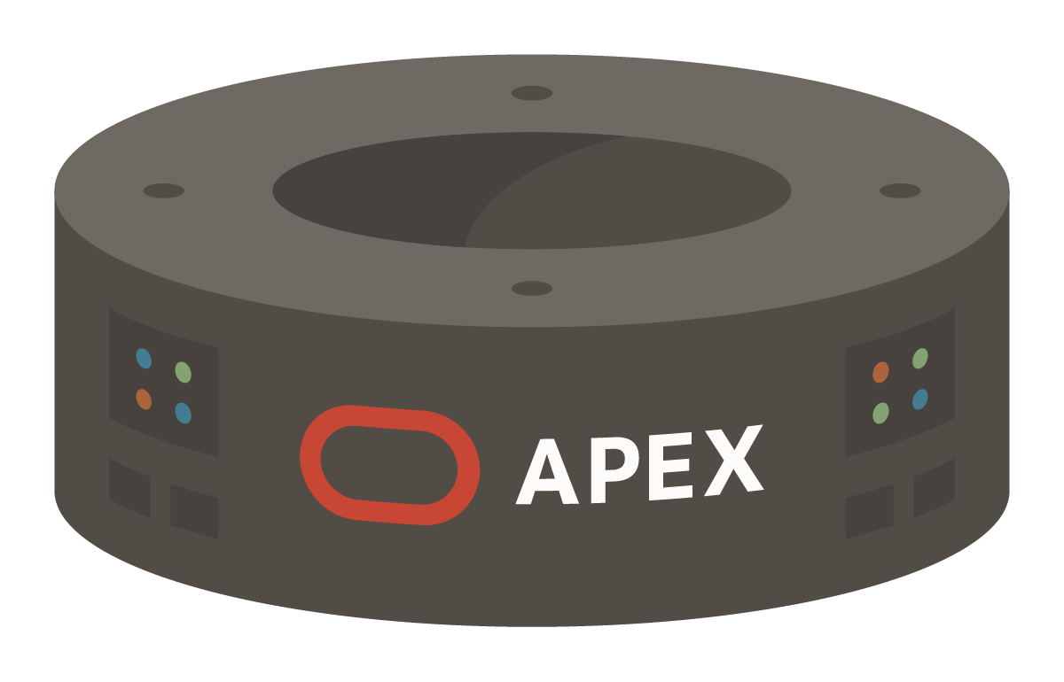


Modern Enterprise Architecture
1 - URL
ORDS
Oracle REST Data Services
4 - HTML
GET
User views details
2 - JDBC
6 - JDBC
3 - APEX
7 - APEX
POST
User clicks a link
Make change and submit
Branch
8 – Branch to URL
Database
REST
5 – HTTPS POST
GET
User clicks a link which sends HTTPS GET request to ORDS
ORDS makes a database JDBC call to the APEX Engine
APEX generates HTML page (full page or partial)
ORDS returns the generated HTML back to the browser
POST
User clicks a button which does an HTTP POST to ORDS
ORDS makes a database JDBC call to the APEX Engine
APEX processes the request
APEX determines URL and branches

Slide 10

APEX Data Sources
Oracle REST Data Services
(Weblogic, Jetty, Tomcat)
External APIs - Web Sources
(REST, SOAP)
HTTP(s)
JDBC
Local Data Source
(SQL, PL/SQL)
Database Links
(SQL*NET)
JDBC
Remote Databases
REST Enabled SQL
[REST / HTTP(s)]
JDBC
Copyright © 2026, Oracle and/or its affiliates
Notes:
Oracle APEX is best suited to being co-located with the data it is maintaining/reporting on – Local Data Source.
Oracle APEX provides the ability to execute SQL not only in the "local" Oracle database (where APEX runs in), but also on a remote Oracle instance. This is based on the REST Enabled SQL feature introduced with ORDS When the REST Enabled SQL feature is active on an ORDS instance, SQL statements can be passed in JSON format using HTTP POST requests. Execution results are being passed back as a self-describing JSON response. Clients thus can communicate with the Oracle database using open protocols and without SQL*Net. A prerequisite for using REST Enabled SQL is to have at least ORDS 17.4 installed. Older ORDS versions (3.0.x) do not support REST Enabled SQL.
Oracle APEX provides declarative support for REST Services in APEX components. That means developers can create a component, such as an interactive report, directly on an external REST service. You can register an external REST Service as a Web Source Module in Shared Components and then use it as the data source for a report and form.
You can also integrate into a SOA environment by consuming Web Services (both REST and SOAP) or utilizing DB Links to other databases.

Slide 11
Single Database Instance and Multiple Workspaces
Oracle Database with APEX
Workspaces used to define application definitions / Schemas hold data
The many-to-many relationship between Workspaces and Schemas
Instance Administrators manage the environment and schema access
Departments can request more space and access to a new schema
Schema 1
Schema 2
Schema 3
Schema 4
1
2
3
Workspace 1
Workspace 2
Workspace 3
Dept. 1
e.g. Sales
Dept. 2
e.g. Support
Dept. 3
e.g. HR
Learn more at apex.oracle.com

Slide 12












Oracle APEX is Available Everywhere
Oracle APEX is a fully supported no-cost feature of Oracle Autonomous AI and all Oracle Database editions
OCI
Autonomous AI Databases
All Autonomous AI DB workload types
Autonomous AI Database for Developers
All Oracle Database editions
Oracle Database@Multicloud
Oracle Exadata
Amazon RDS for Oracle Database
High-Performance Database Options
Oracle Base Database Service
Oracle Exadata Service
Oracle Database Free
All other major clouds via VM
Always free tier
Always Free APEX Service
Always Free Autonomous AI Database

Slide 13




Oracle APEX on ADBS: workload-optimized instances
Oracle Autonomous AI Database Serverless with APEX
Lakehouse
Full ADBS service optimized for analytics and AI workloads
Transaction Processing (ATP)
Full ADBS service optimized for
transactional and mixed workloads
One-click, data-preserving operation:
JSON Database
Specialized JSON service, limited relational storage, low price
APEX Service
Specialized APEX service, no SQL*Net connectivity, low price
= Workload Type Conversion

Slide 14
DEVELOPMENT EVOLUTION
Generative development expands how teams build with APEX
Declarative development remains the foundation. AI now assists in app builder and coding agents turn specifications into scaffolded applications.
BEFORE 24.1
24.2
26.1
Visual & Declarative
Generative Development
AI Coding Agent
App Builder
APEX Assistant in Builder
APEXlang + Blueprints
Pages • components • SQL • PL/SQL
Generate • explain • improve • debug
Intent as source • Spec → scaffold
Choose the approach that fits the work - all paths use the same APEX environment.
11
Copyright © 2026, Oracle and/or its affiliates
14

Slide 15
Choose the Gen-Dev approach with APEXlang
INPUT FILES
Requirement Document
Schema Metadata
Choose the
approach
DETERMINISTIC
NON-DETERMINISTIC
Blueprint Scaffolding
APEXlang Skills
AI Coding Agent
AI Coding Agent
Requirement + schema + System prompt
Requirement + schema + APEXlang Skills
Blueprint
APEXlang Project
Structured Markdown application definition
Agent generates source directly
Import Blueprint
Import App
Generates a predictable baseline APEX application
Creates APEX application
APEX Application

Slide 16
APEXlang
Open application specification language for data-centric APEX apps as clear-text, human-readable .apx source.
.apx source package
Structured application metadata in clear-text, AI-ready .apx source
Readable
Versionable
Validatable
AI Optmized
Scan application intent and metadata as text beside the Builder experience.
Review diffs and version application changes in Git.
Validate APEXlang source before import through supported tooling.
Designed for AI–assisted development
APEXlang turns low-code into a compilable language: AI can generate it, developers can inspect it, and enterprises can govern it.
33

Slide 17
Spec-Driven Development
The functional specification becomes the contract before APEX validates and materializes the app.
Schema Metadata
Blueprint
APEXlang
Tables
Structured Markdown plan
generated from requirements
and schema context
Open .apx source for review, validation, import/export, and automation
Functional specification
Views
Business Logic
Constraints
User Flows
Process Rules
Review before import
Controlled source path
Inspect the Blueprint before APEX materializes application metadata.
Blueprint bootstraps the app; APEXlang supports ongoing source-based delivery.
Personalization
System Prompt
A deterministic system prompt that instructs an LLM to generate Oracle APEX application blueprints from functional requirements and schema metadata.
SOURCE OF TRUTH
35

Slide 18






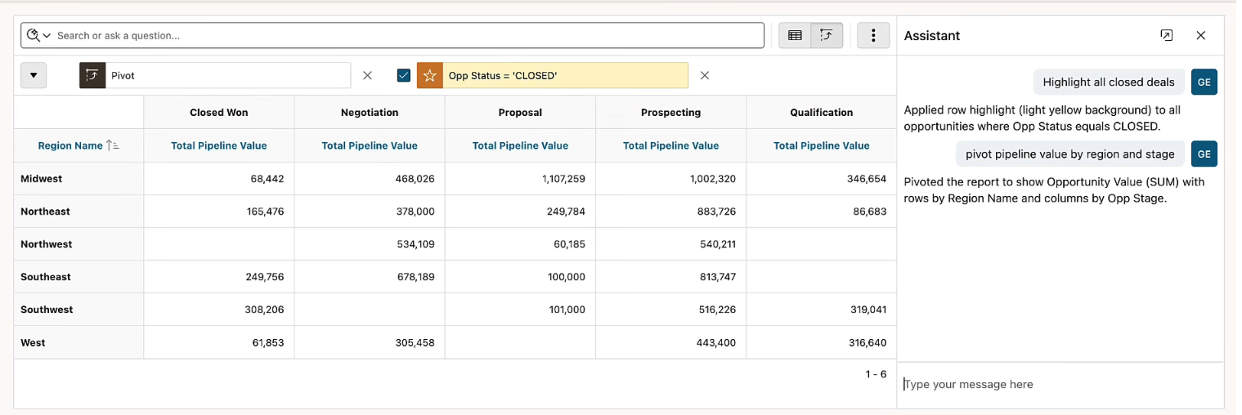
AI Interactive Reports
Natural language becomes visible, editable, native Interactive Report settings.
Plain language queries becomes visible standard Interactive Report settings, not a separate reporting artifact
What users ask for
Ask the report in plain language
Plain-language requests through Search with AI or the Assistant: filter, group, pivot, chart, highlight, save, reset.
filter
sort
pivot
chart
highlight
aggregate
What APEX sends
Report definition, column metadata, reference values, report context, column context, and current report state.
What stays protected
Business data stays in the environment; the Assistant applies settings and does not display data, analytics, or summaries.
Why it feels governed
Every AI-applied configuration is surfaced as a visible, reviewable chip.
Natural-language actions are limited to enabled Interactive Report capabilities and disabled until developers opt in.
41

Slide 19
AI Agents
APEX AI Agents can reason over user intent, retrieve context, call approved tools, and return a final answer or completed action while developers control the boundaries.
Developer-governed
Approved tools, typed parameters, authorization, and human approval for sensitive actions.
Core loop
Beyond chat
1
Reason over intent and move work forward.
1
2
3
4
2
Declarative tools
Intent
Context
Tool
Action
Expose curated SQL, PL/SQL, and JavaScript capabilities.
Understand the user's goal.
Retrieve relevant data or rules.
Call an approved capability.
Return a result or complete work.
APEX manages context, dispatches tool calls, executes tools, returns results, and composes the response.
3
Controlled execution
Use typed parameters, scoped access, and human checkpoints.
Confidential: Internal/Restricted/Highly Restricted
43

Slide 20
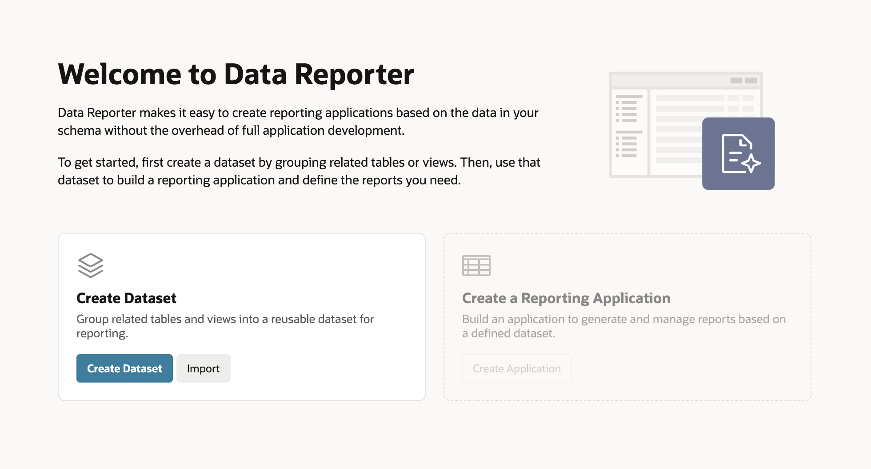
Data Reporter
A dedicated APEX reporting module for business-led, governed self-service reporting
No Page Designer for report authors
No SQL required for report creation
Private drafts before publishing
Developers define the safe reporting foundation

Slide 21
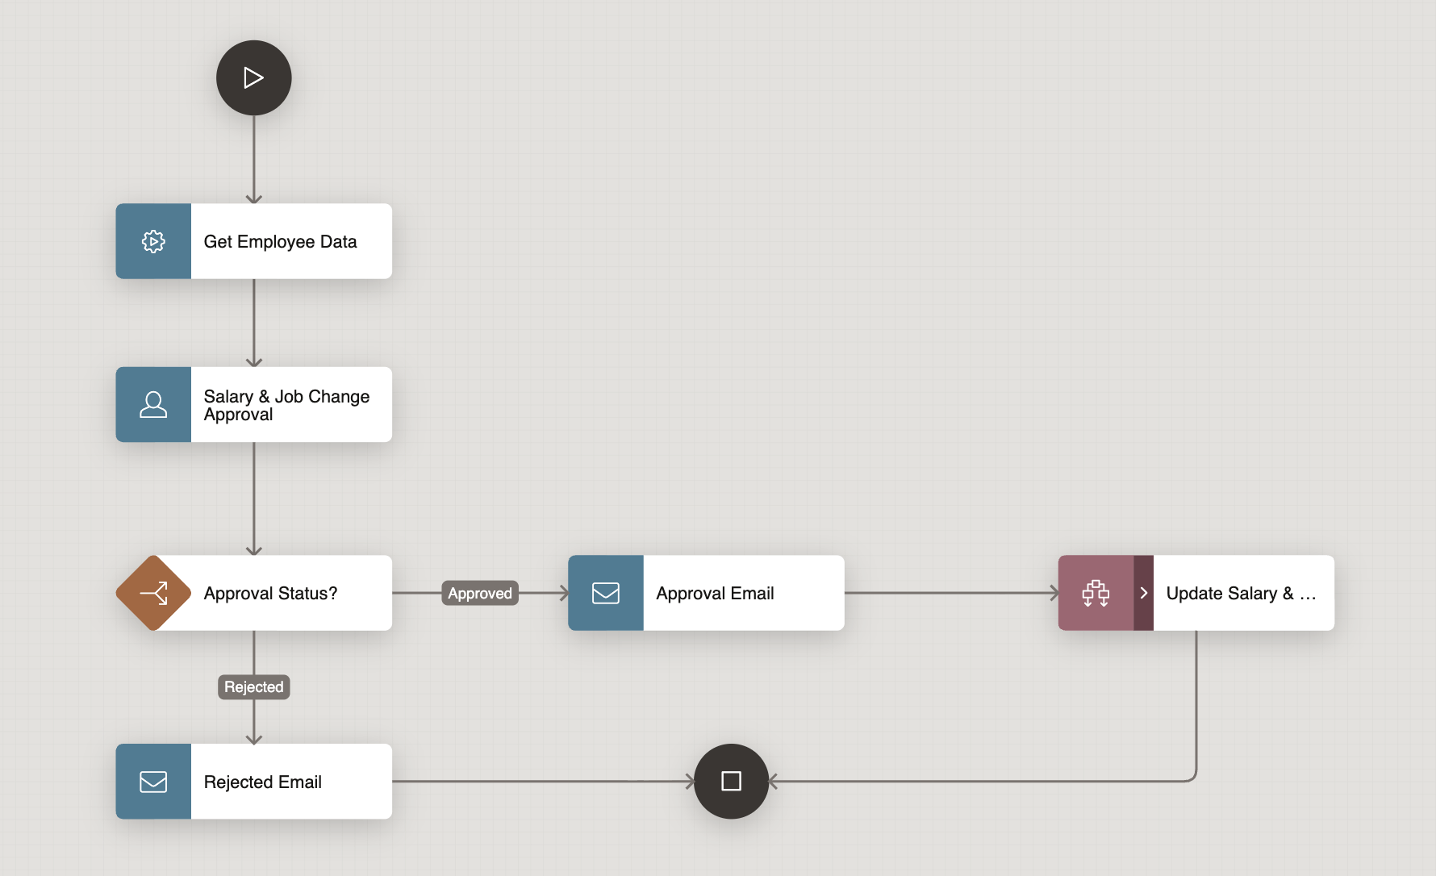
Workflow
Stateful process orchestration across system steps, human tasks, approvals, conditions, and AI-assisted actions
1
Start
Start Workflow
2
System Activity
SQL, PL/SQL, API
3
Human Task
Approval or Action
4
Decision
Rule or Outcome
5
Parallel Flow
Branches together
6
Complete
End Workflow

Slide 22
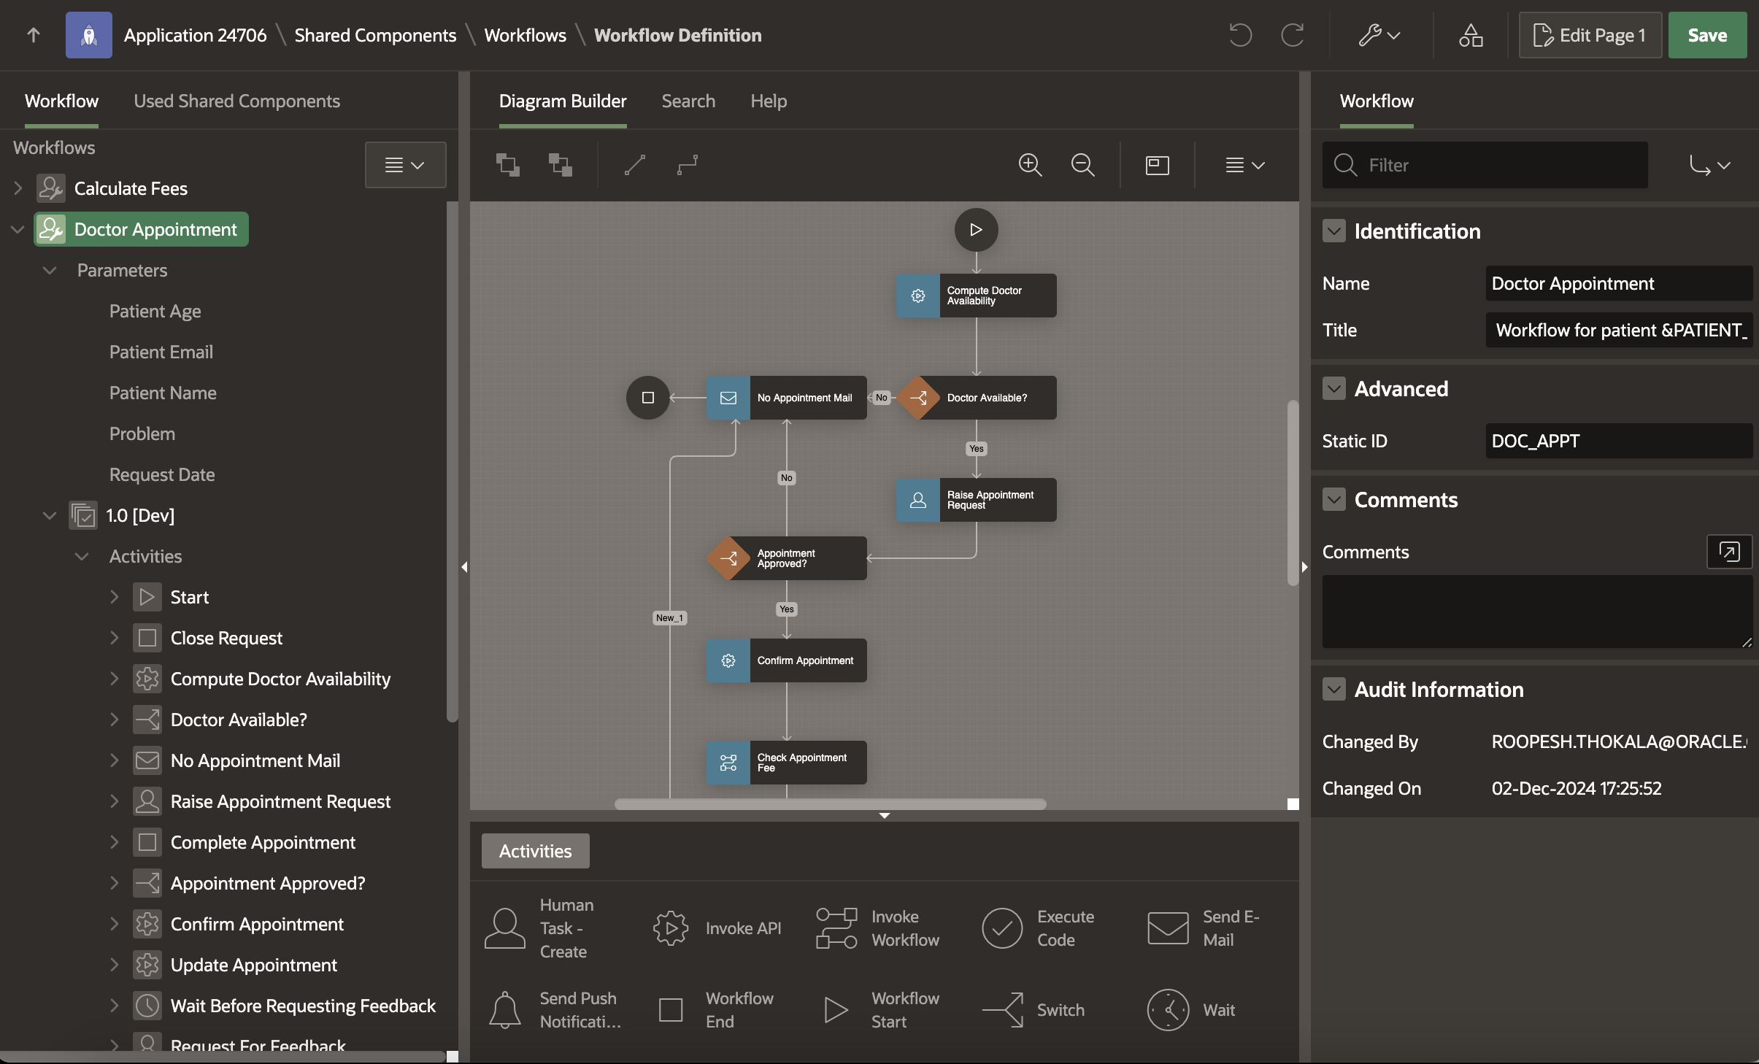
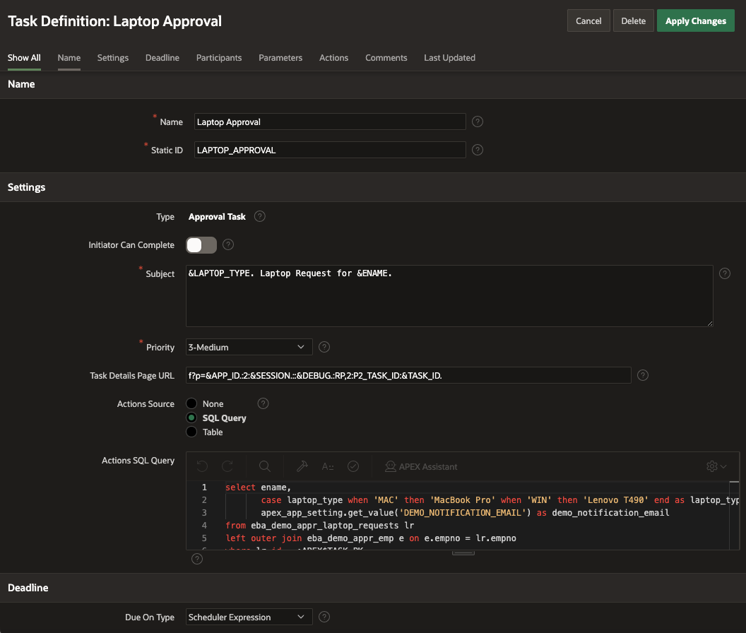
Process Automation
Business processes move tasks, information, and approvals between systems and people.
System-to-system automation
Coordinate service calls, database work, and application events.
Human workflow
Route approvals and actions to accountable participants.
Operational state
Track payload, comments, outcomes, and history in the application.
Core capability
Workflow is part of the APEX application runtime, not a disconnected tool.
Confidential: Internal/Restricted/Highly Restricted
47

Slide 23
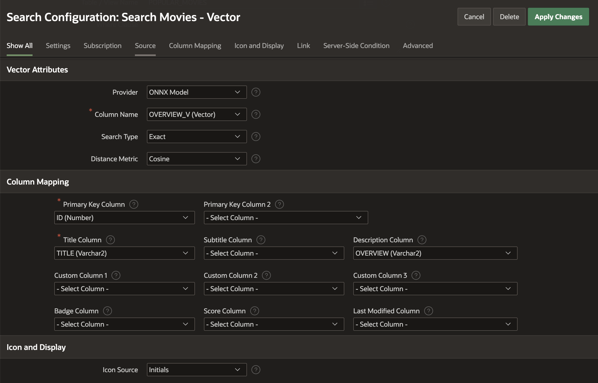
Vector Search Support in Search Configurations
Vector search in APEX Search Configurations uses Oracle Database vector capabilities to return semantically similar results.
Developers configure index usage, distance metrics, maximum distance, and result limits while keeping search behavior declarative.

Slide 24
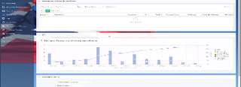
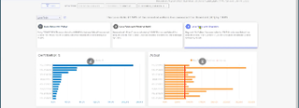
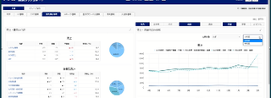
Customer Stories
Customer outcomes prove small teams can deliver enterprise systems quickly
The strongest proof is not logos alone. It is speed, scale, regulated use, and real operational outcomes.
Siemens Mobility
Munich RE HealthTech
Nomura Research Institute
Integrated project management
Multi-tenant sovereign SaaS
Fraud, GRC, dashboards
Connected 14+ systems including SAP and Snowflake on OCI; three developers delivered in under three months.
Health-insurance data sovereignty across 10+ countries, running APEX on AWS and OCI; four developers in under two months.
APEX apps on OCI Dedicated Region; first fraud/GRC app delivered by two developers in under two weeks.
Operations and modernization
Regulated global scale
Risk and analytics

Slide 25
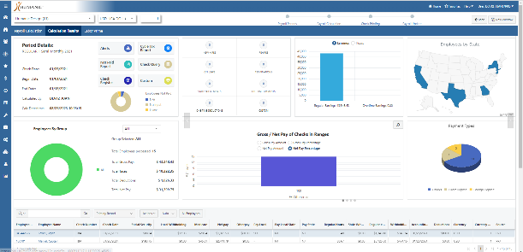
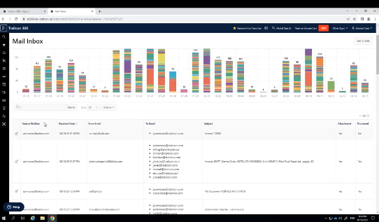
Ops & Modernization
Small teams delivered modernization and automation outcomes quickly.
Siemens Mobility
Siemens Mobility
Humanic
Trailcon
Integrated project management on OCI, connecting 14+ systems including SAP and Snowflake; three developers in under three months.
Modernized 300+ legacy forms; on-premises today and moving toward APEX on OCI; four developers in under 90 days.
Automated invoice processing with AI, APEX, OCI AI services, Email, and Object Storage; four developers in under three months.
56

Slide 26
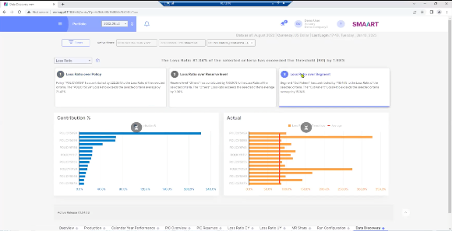
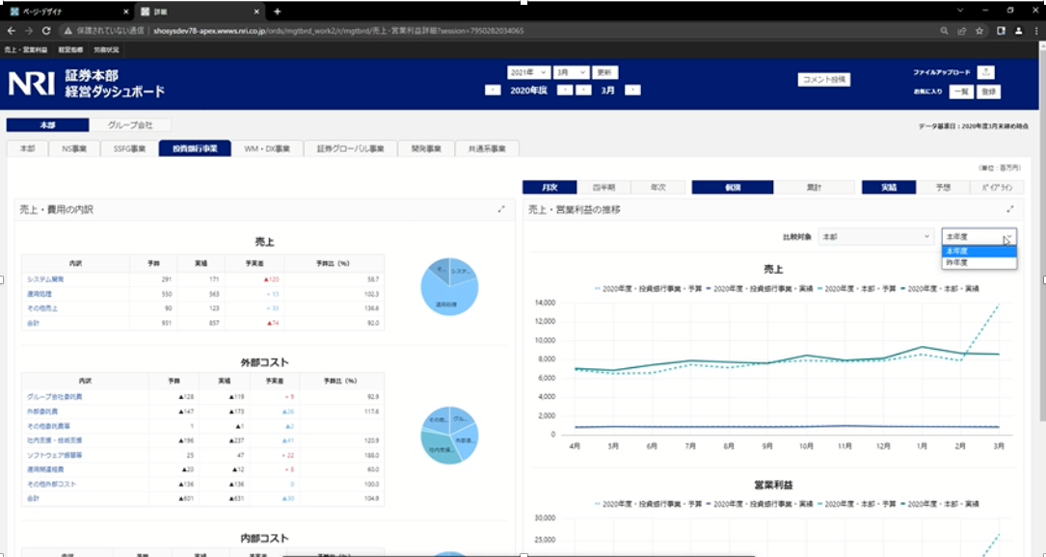
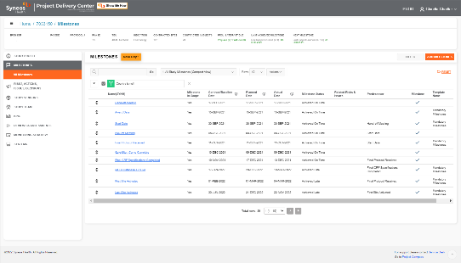
Regulated Scale
APEX supports regulated, sovereign, and analytics-heavy enterprise scenarios.
Siemens Mobility
Munich RE HealthTech
Nomura Research Institute
Syneos Health
Multi-tenant health insurance SaaS for data sovereignty across 10+ countries; APEX on AWS and OCI; four developers in under two months.
57
Fraud detection, GRC, and executive dashboards on OCI Dedicated Region; first app by two developers in under two weeks.
Clinical trial oversight with AI and APEX across hybrid on-premises and OCI; four developers in under three months.

Slide 27
Global Scale Proof: Samsonite, Star CRM, NEC
APEX supports global operations, cost control, and rapid modernization across different operating models.
Samsonite Europe
Star CRM
NEC
Moved luggage-damage services to OCI for higher availability and scale.
Reported 40% higher productivity and 25%-30% savings after moving APEX workloads to Oracle Database Cloud.
Selected Autonomous Transaction Processing with APEX on OCI for cost efficiency and integrated development.
Cloud service scale
Productivity and cost
Cloud database platform
Common thread: Oracle Database, OCI, APEX, and enterprise controls let small teams deliver business-critical systems quickly.

Slide 28
Industry Proof: NIBIO, Shimizu, Tanishq
The platform applies across research, construction, retail, public sector, and operational analytics.
NIBIO
Research analytics
Forest and sensor-data analysis with APEX, OCI Data Science, and Autonomous Data Warehouse.
Construction-site digitization using APEX, Autonomous Data Warehouse, and Oracle Analytics Cloud.
Shimizu
Field operations
Inventory and Endless Aisle service needs delivered with APEX and OCI.
Tanishq
Retail operations
Proof theme: one platform adapts to very different domains without changing the core database-centered architecture.

Slide 29
Use Cases
Learn more at apex.oracle.com

Slide 30


Modernizing Oracle Forms
Evolve your Forms Apps to APEX apps and unlock limitless possibilities!
Features
APEX is the natural evolution of Forms
Both are based on SQL and PL / SQL
Re-use DB packages, procedures, functions
Easily train Forms Developers into developing with APEX
Forms App
Solutions
Proof-of-concept using the subset of Forms apps
Organization-wide apps, rather than back-office
External apps for customers/partners
Mobile-first apps
Net new requirements
APEX Application
Notes:
If talking to a Forms customer ask what there plans are.
If looking to move off push APEX as it is by far the easiest way to modernize their legacy Forms apps
## Virtual Trader; Carnival Cruises

Slide 31
Mission Critical Enterprise Systems
Features
Quickly build custom mission-critical apps
Corporate data reporting and maintenance
Merge separate data silos
Build organization-wide self-reporting apps
Solutions
Simple deployment
Single installation runs any number of apps
Scale to hundreds of thousands of users
Notes:
As proven by the many APEX mission-critical apps within Oracle (such as the Oracle Store and ARIA People),
your customers can readily build enterprise class aps
## Utah DOT; Oracle Store, Einstein, ARIA People

Slide 32

Extending Enterprise Systems
Enhance your existing apps by building APEX apps!
Features
Extend ERPs and other enterprise software
Provide organization-specific dashboards
Improved workflows
Fill gaps
Existing Apps
Solutions
Meet non-standard requirements
Optimize common business functions
Enhance data capture
Integrate disparate data sources
See: Extend E-Business Suite using APEX
Official Technical paper
APEX Application
Learn more at apex.oracle.com
Notes:
All ERPs / COTS have GAPS!!!!!!!
Used for extending Cloud ERP, FA, EBS, COTS Software to streamline for your business processes or meet organization specific requirements
Can readily lift and shift EBS with APEX extensions to the cloud
## Uni New Mexico; Stanford – Peoplesoft; Swarthmore College – Ellucian Banner
OTAUG = SIG

Slide 33
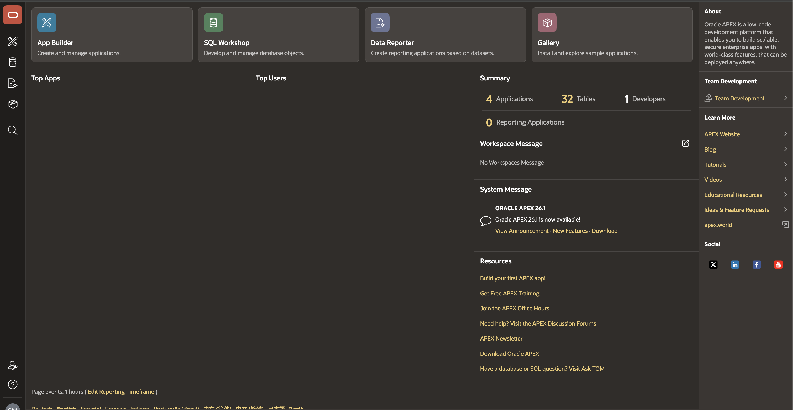
APEX Home Page
The APEX home page brings App Builder, SQL Workshop, Gallery, Data Reporter, and workspace administration into one browser-based starting point.

Slide 34
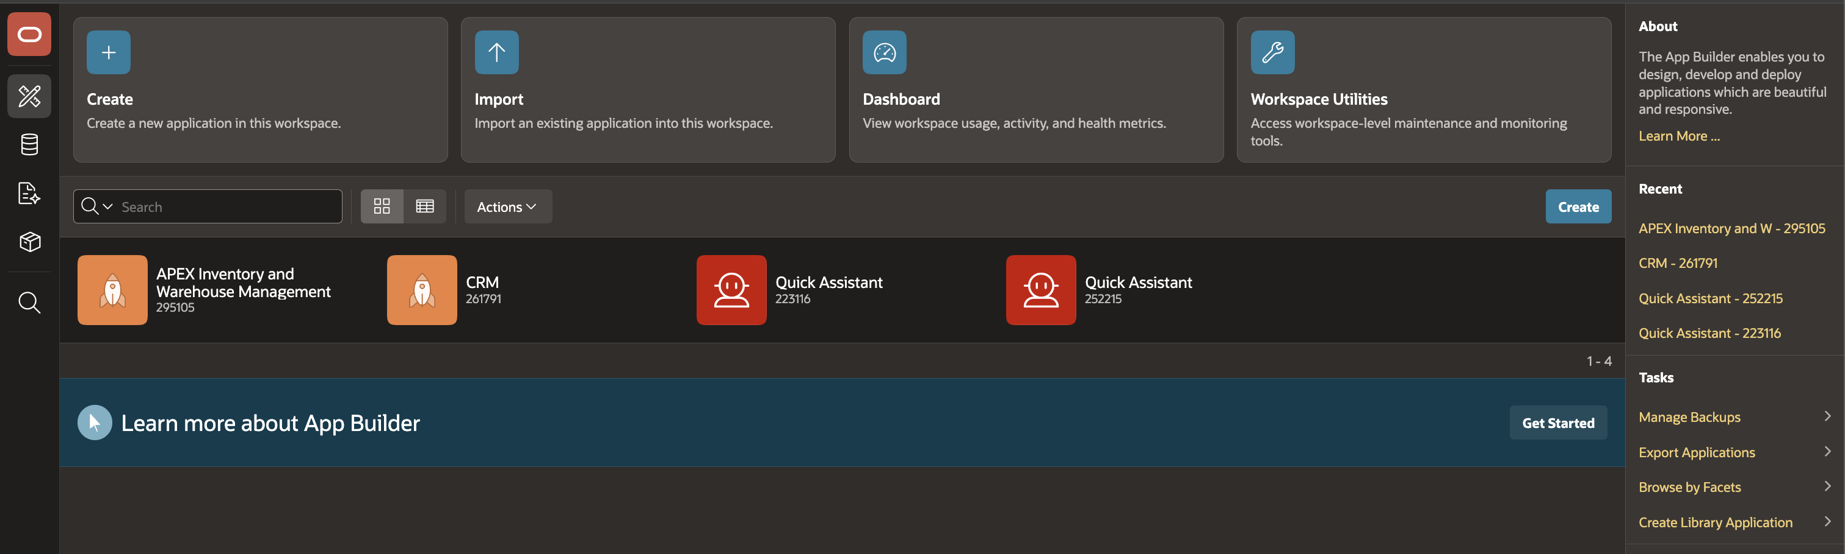
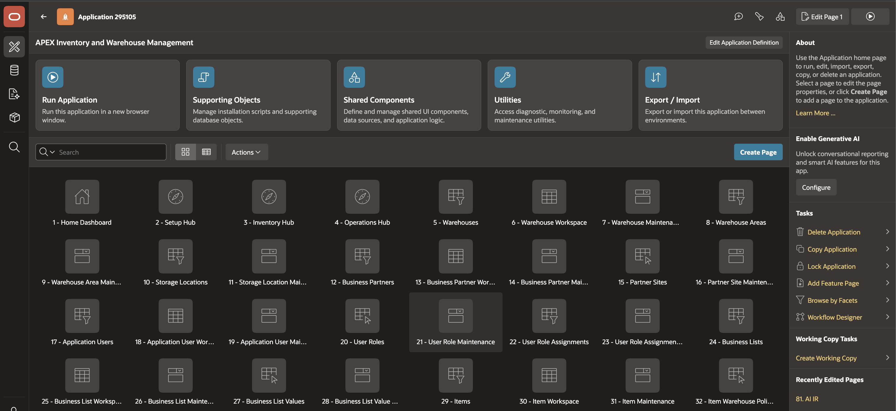
App Builder
App Builder is the main development workspace for applications, shared components, and page-level behavior, with SQL and PL/SQL close at hand.

Slide 35
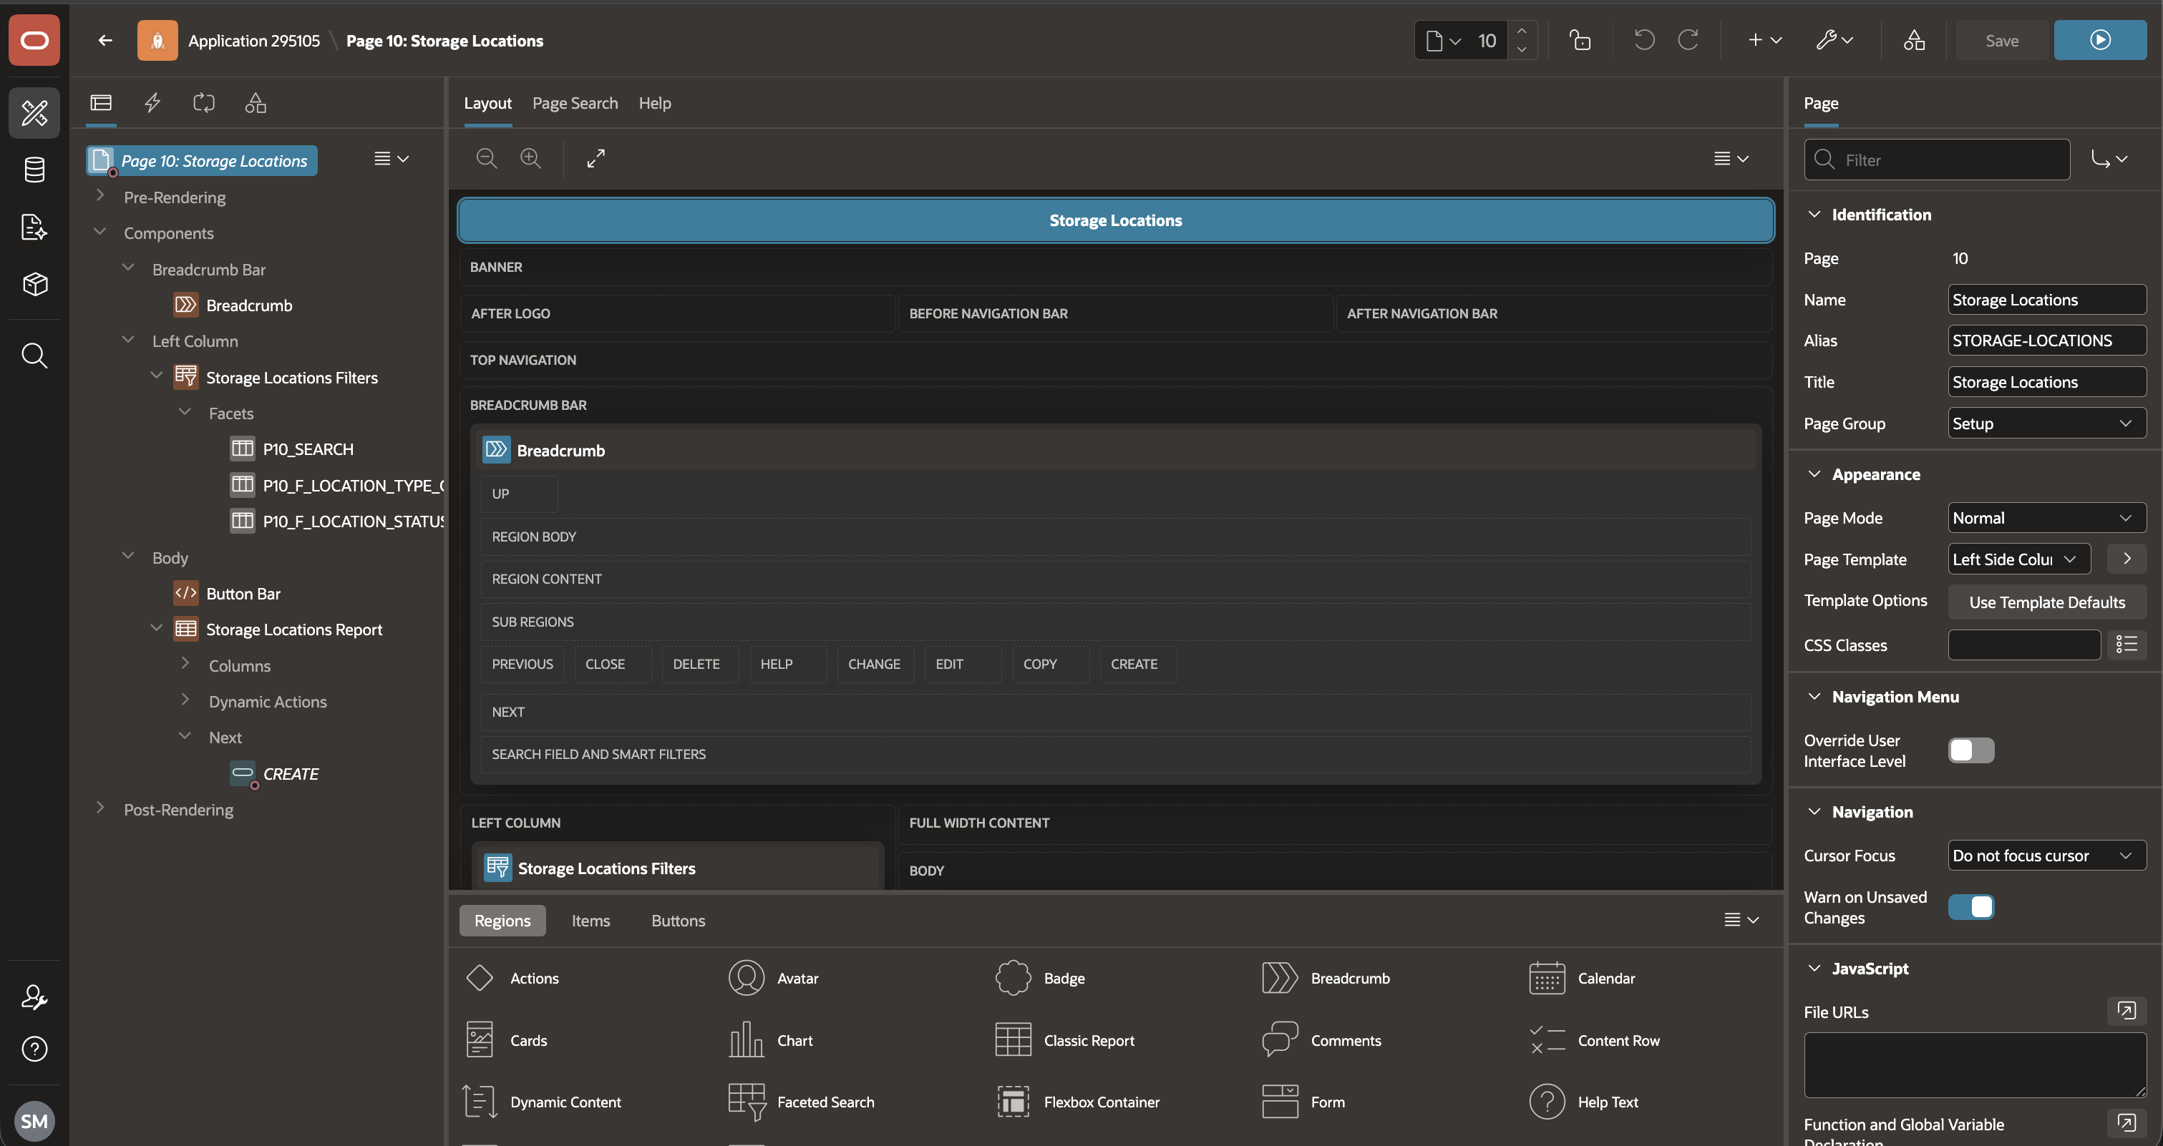
Page Designer
Page Designer gives developers one workspace for layout, components, attributes, processing, validations, and Dynamic Actions.

Slide 36
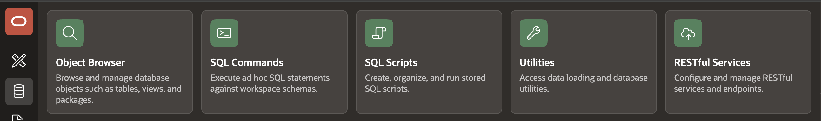
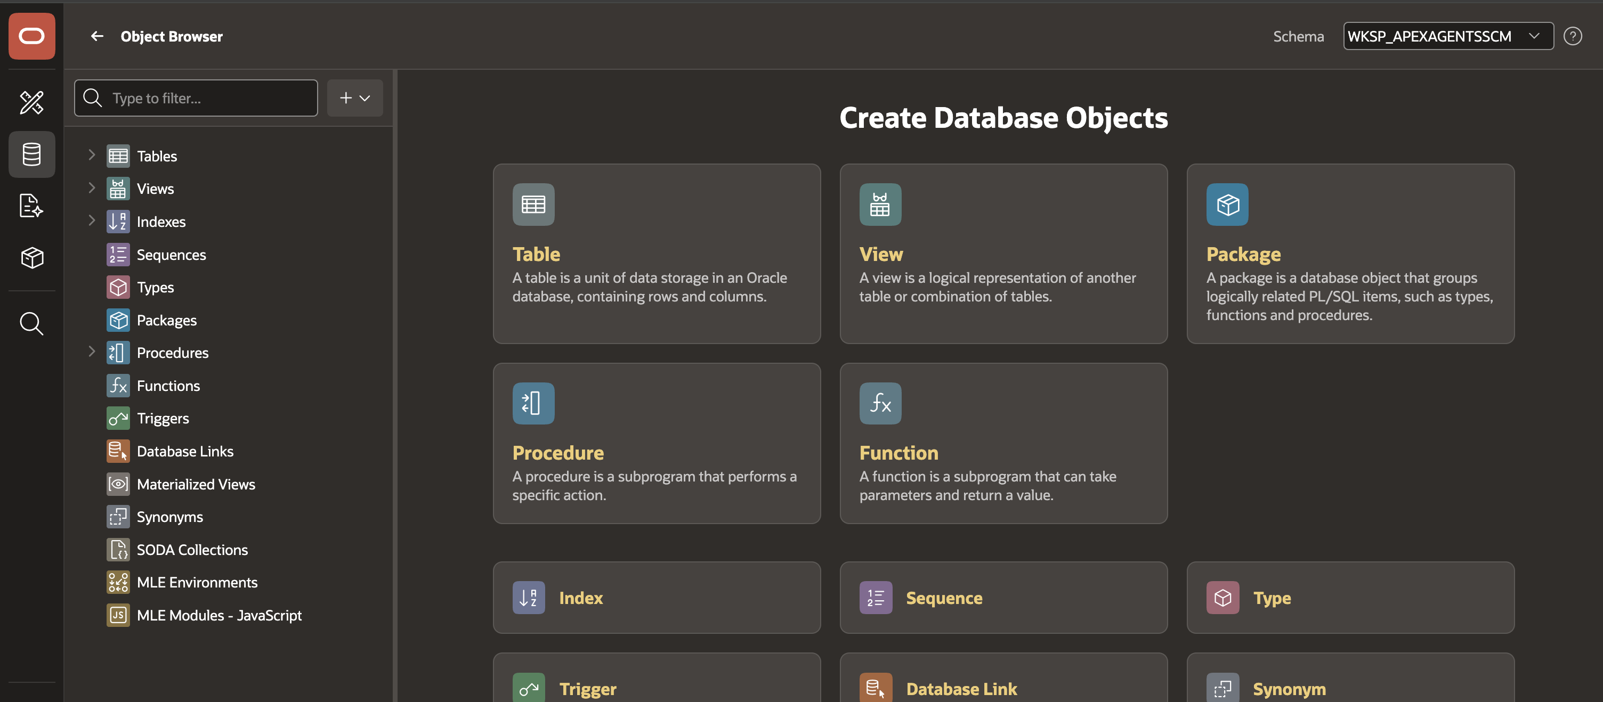
SQL Workshop
SQL Workshop lets teams browse database objects, run SQL, load data, model structures, and expose RESTful services from the browser.

Slide 37
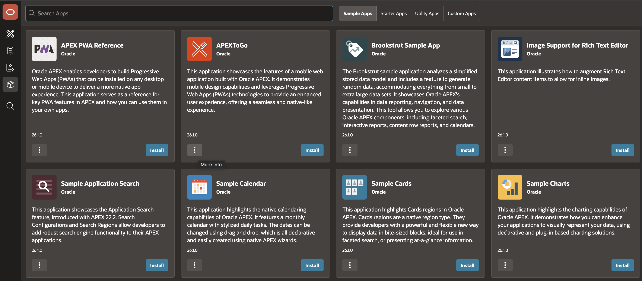
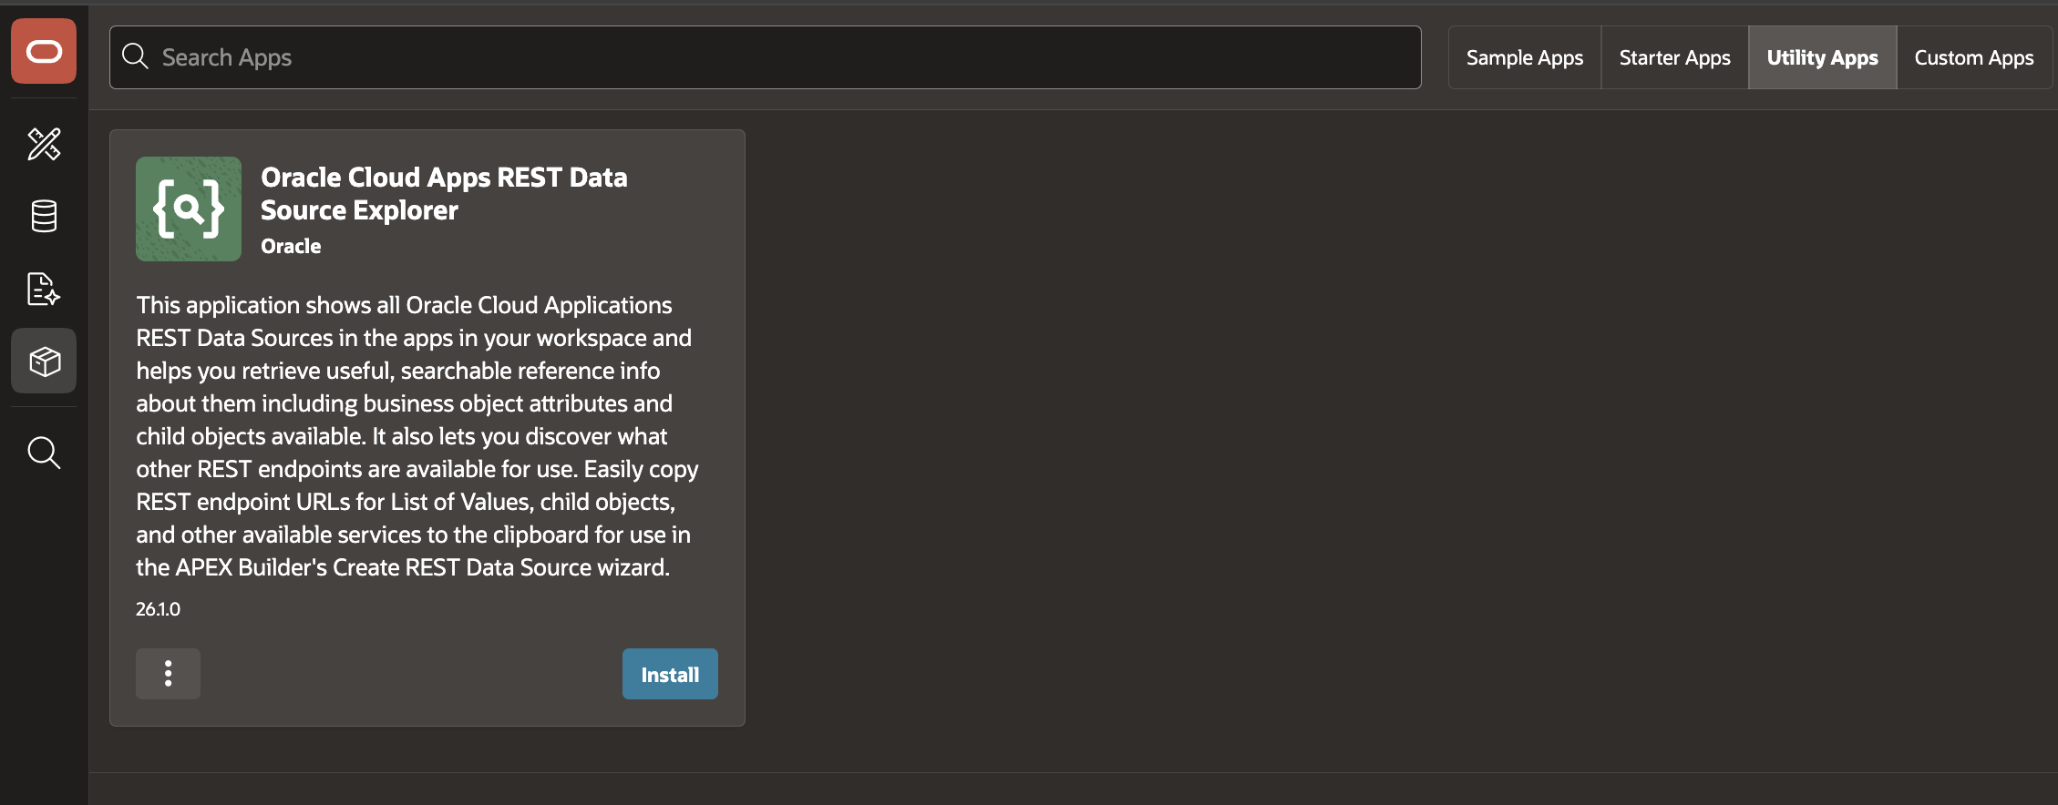
Gallery
Gallery helps teams start from working examples and reusable patterns, then adapt them in App Builder instead of beginning from an empty page.

Slide 38

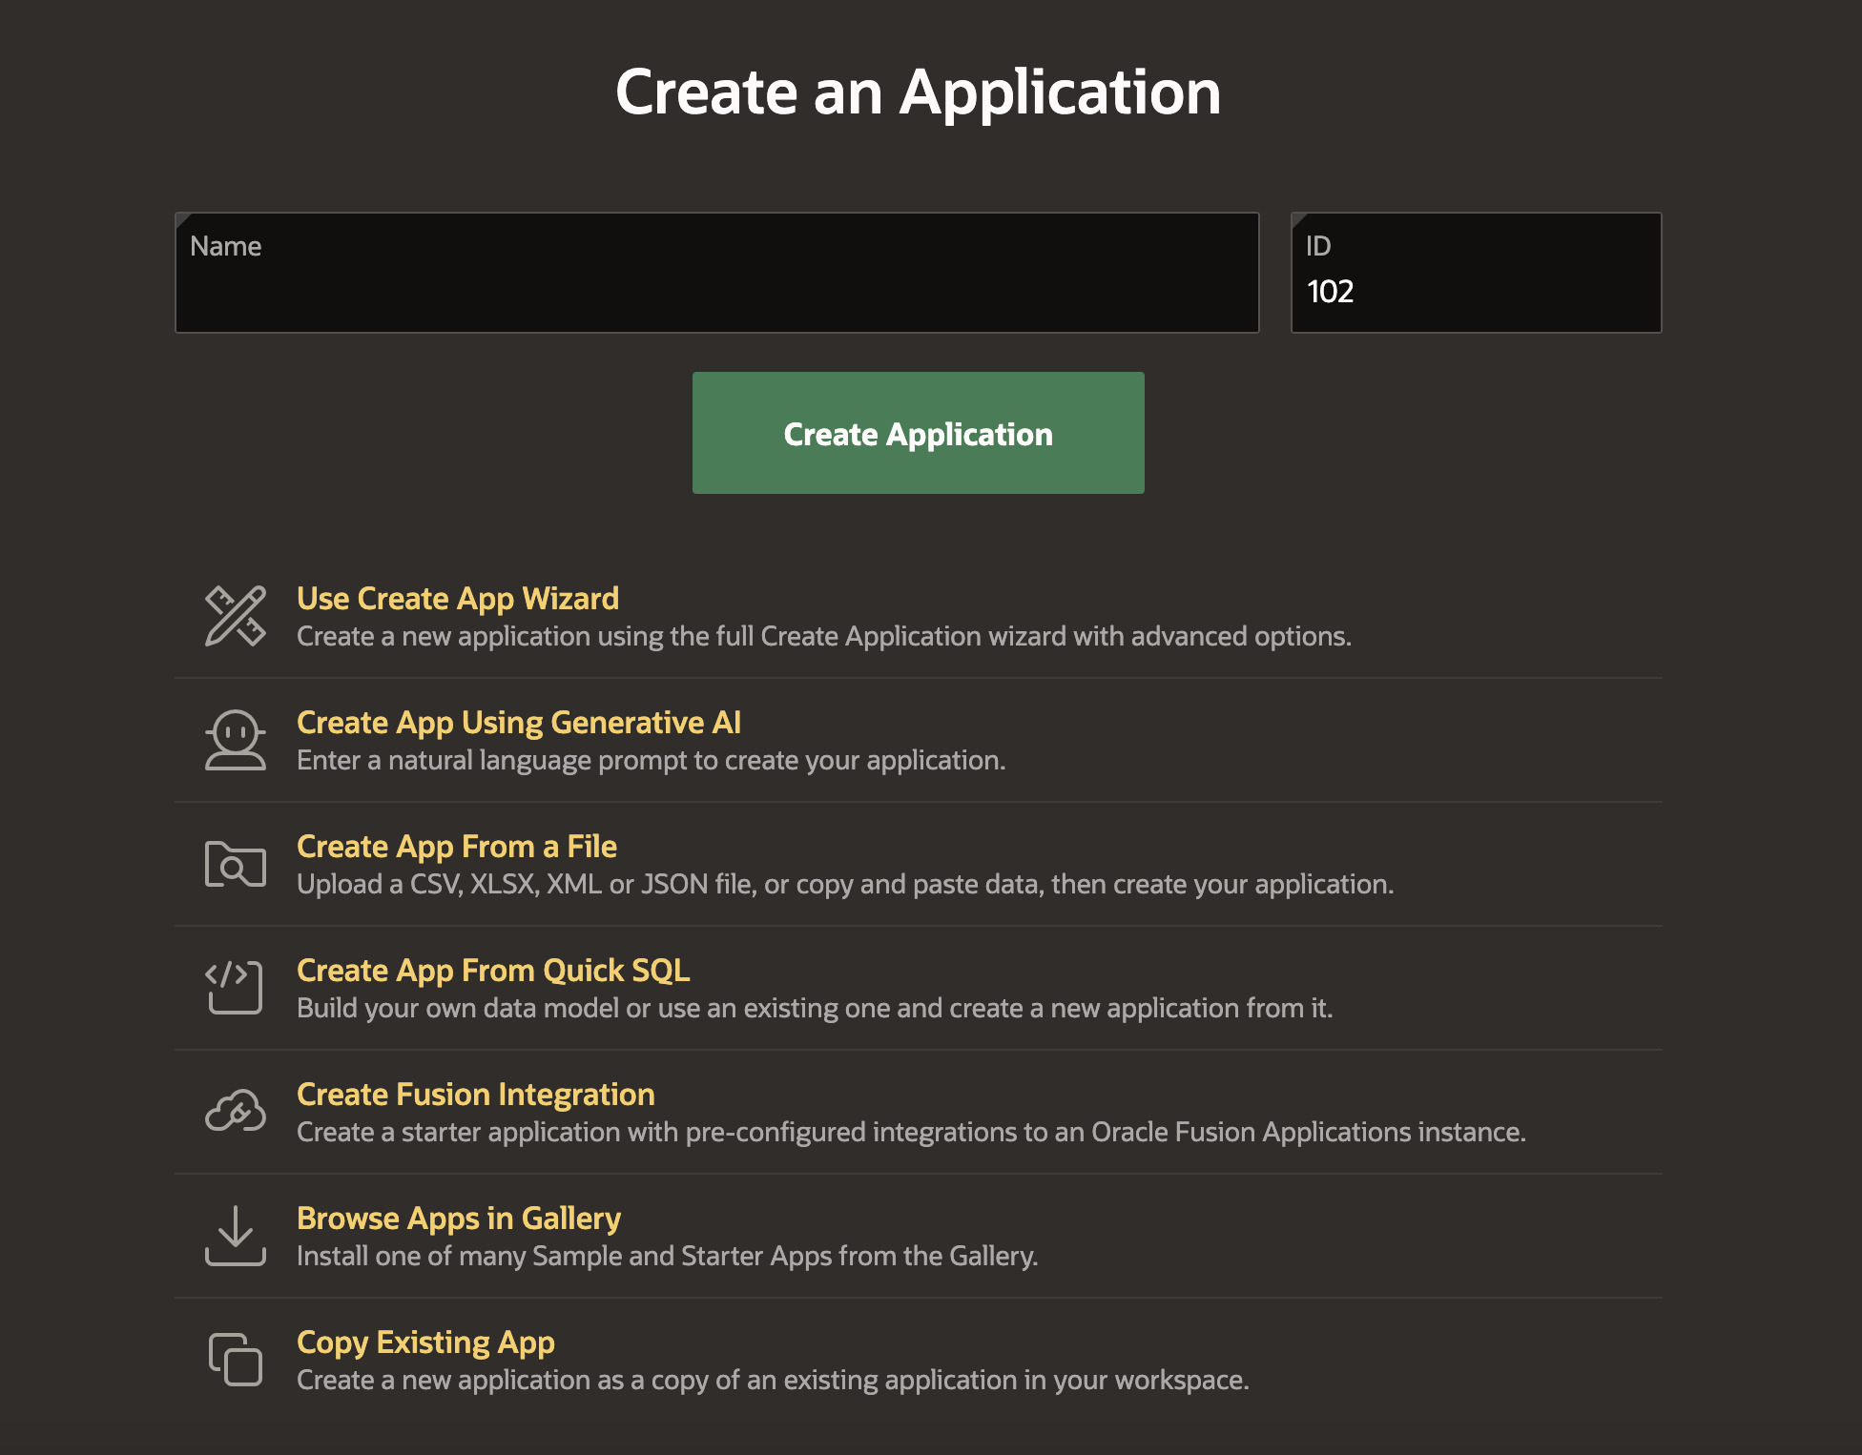
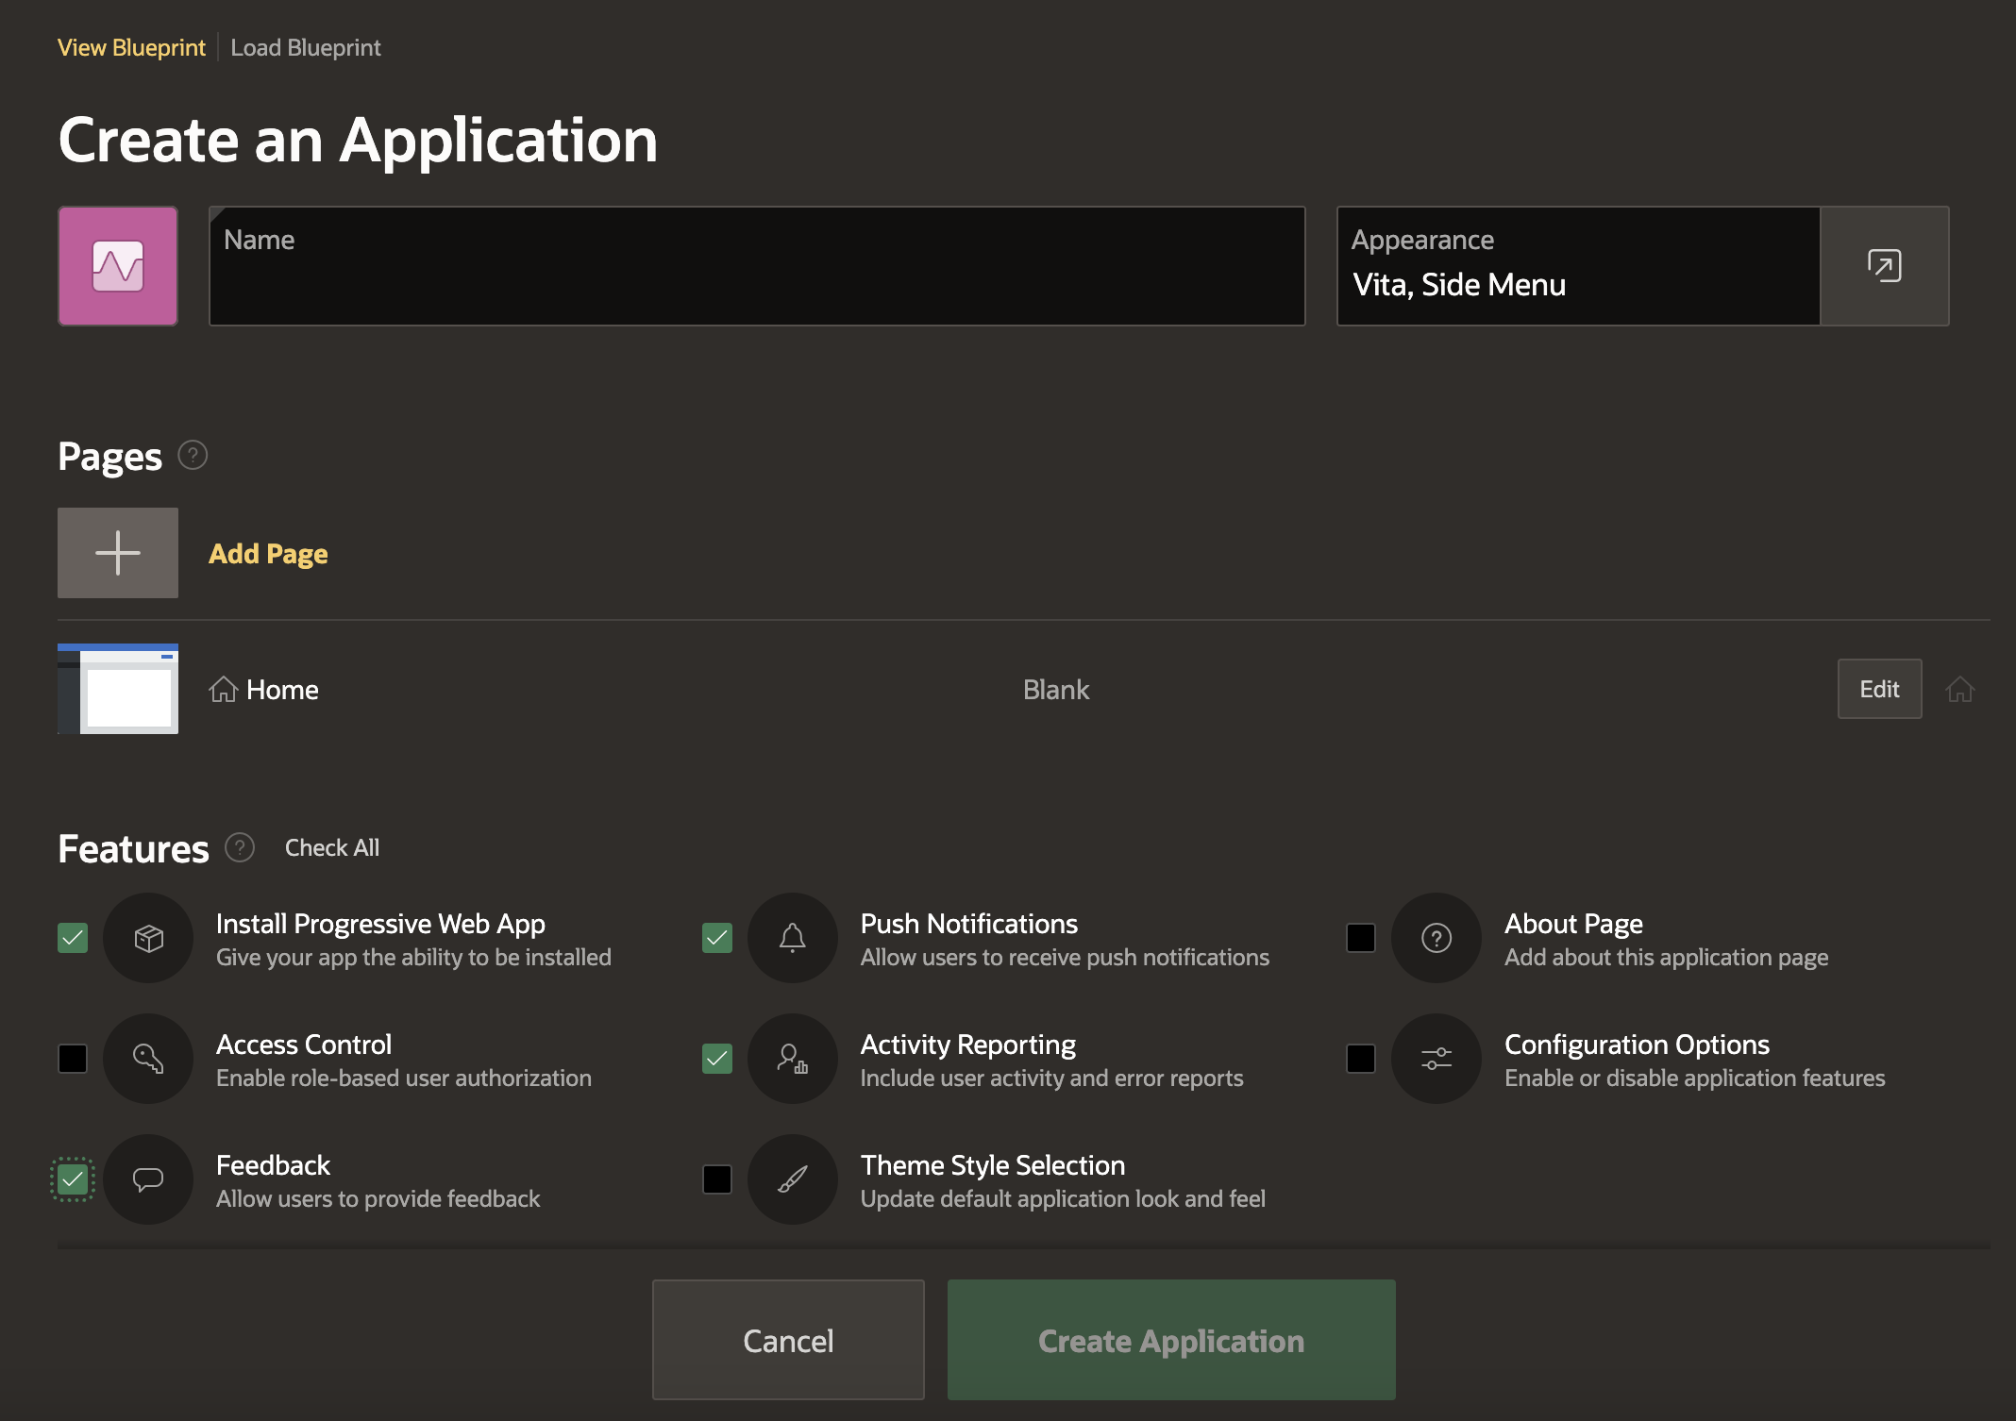
Create Application Wizard
The Create Application wizard turns a data model and app intent into a working application shell.
Teams can add common features such as access control, activity reporting, theme style, icons, and starter pages during setup.

Slide 39
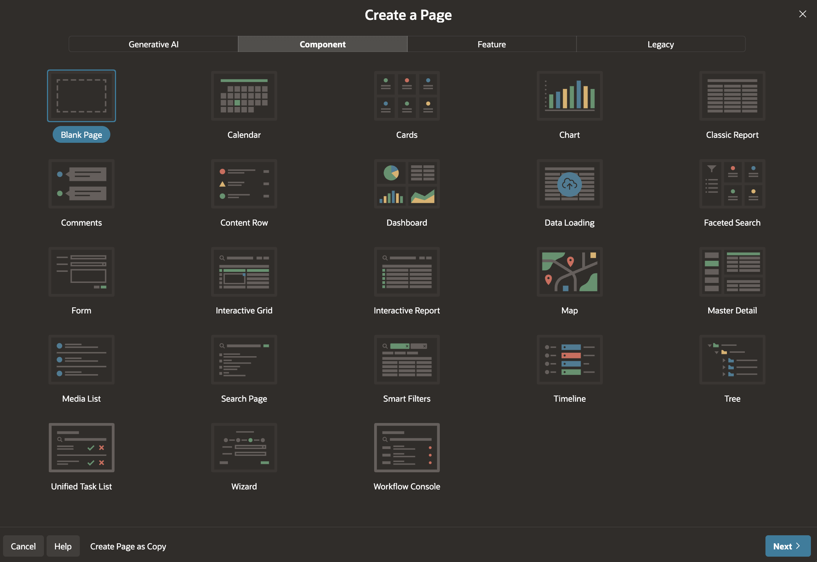
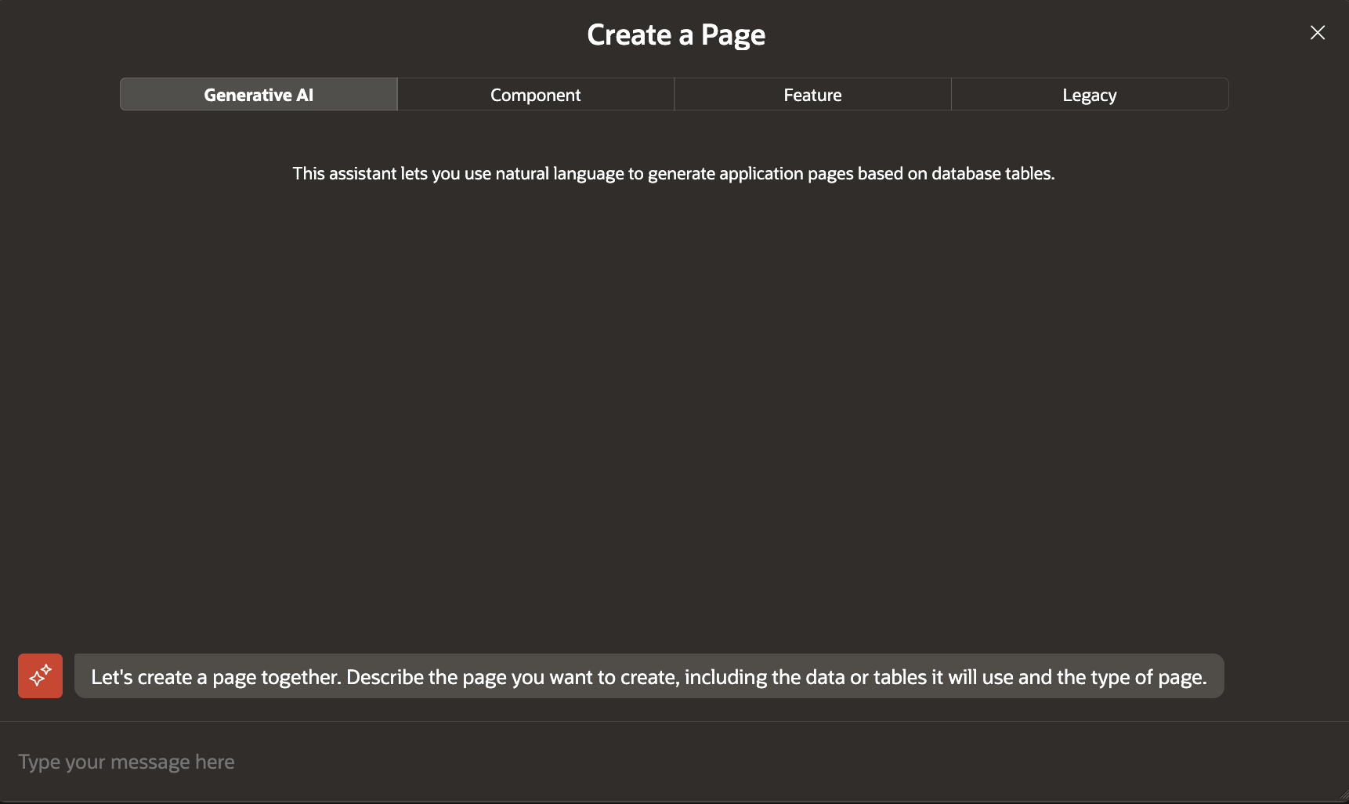
Create Page Wizard
The Create Page wizard adds new capabilities to an existing app without starting over.
Developers can create dashboards, master-detail pages, list views, reports, forms, and mobile-friendly experiences from guided patterns.

Slide 40
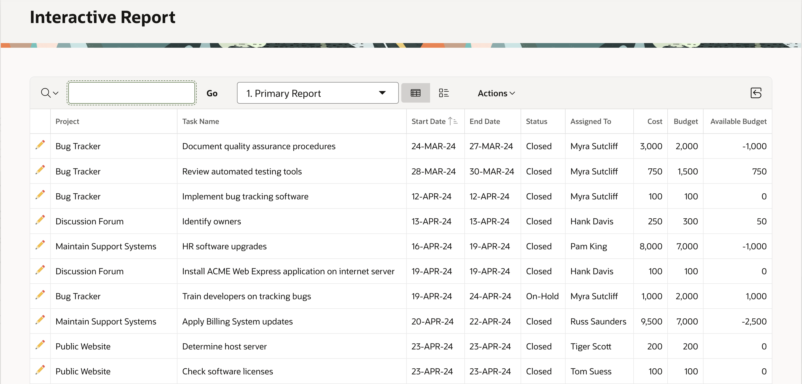
Interactive Reports
Interactive Reports give end users sortable, filterable, personalized report views without custom code.

Slide 41
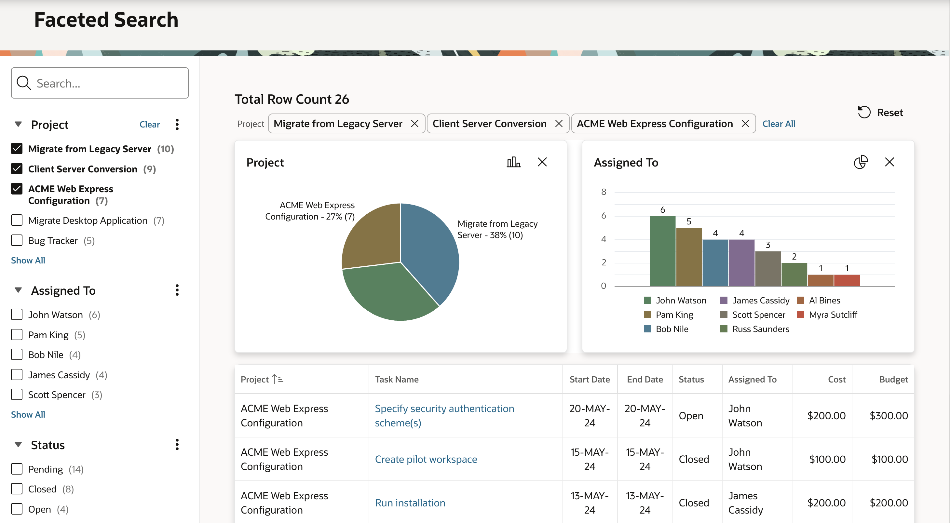
Faceted Search
Faceted Search helps users narrow large datasets through visible, count-aware filters that make exploration feel immediate.

Slide 42
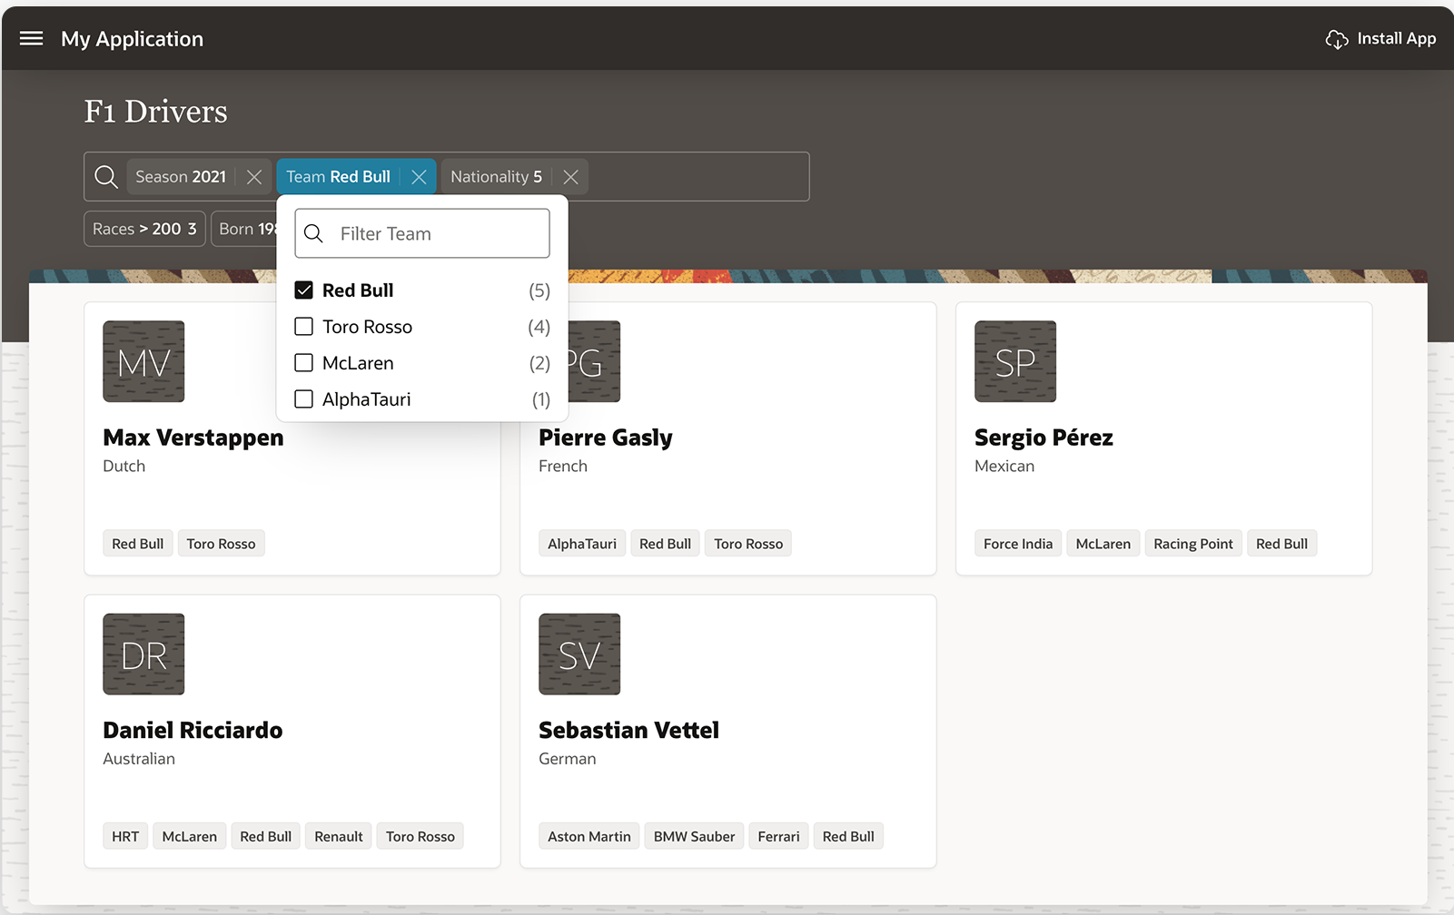
Smart Filters
Smart Filters combine a search bar, filter suggestions, auto-complete, and chips so users can refine data quickly without learning a complex query language.

Slide 43
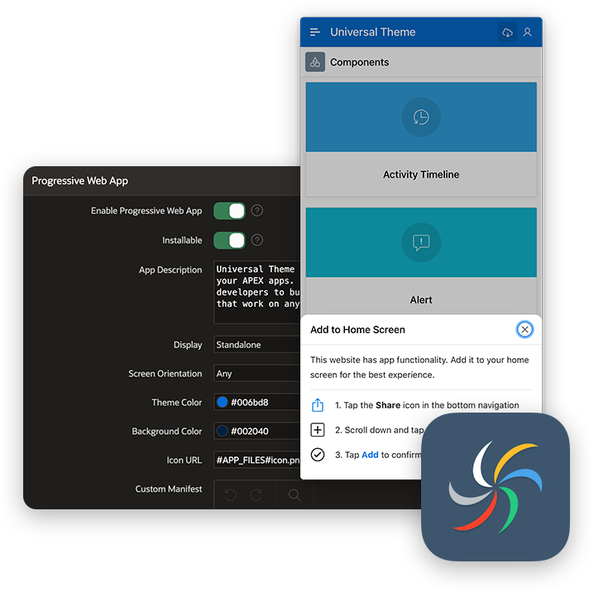
Progressive Web Apps
Progressive Web App support lets APEX applications feel more native on devices.
Apps can be installed, use branded icons and colors, show offline pages, improve load behavior with caching, and use device capabilities such as notifications, geolocation, sharing, and camera access.

Slide 44
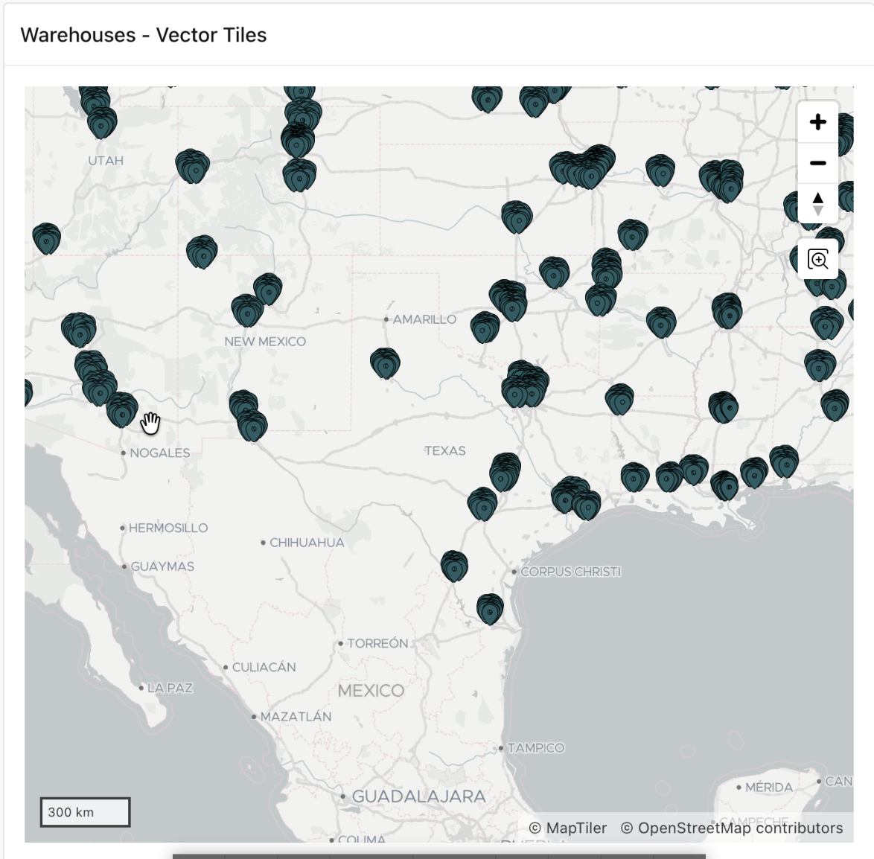
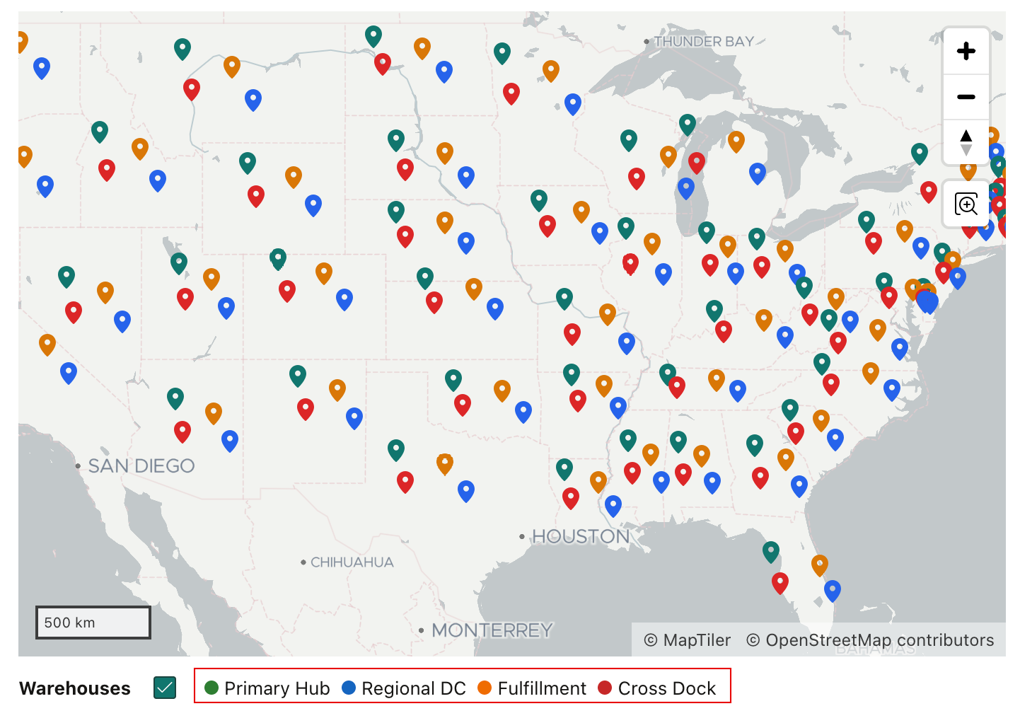
Maps
The native Map component brings spatial context into APEX applications without a separate mapping stack.
Teams can layer points, lines, polygons, 3D polygons, heat maps, and custom background tiles, including raster, vector, and OGC WMS layers.

Slide 45
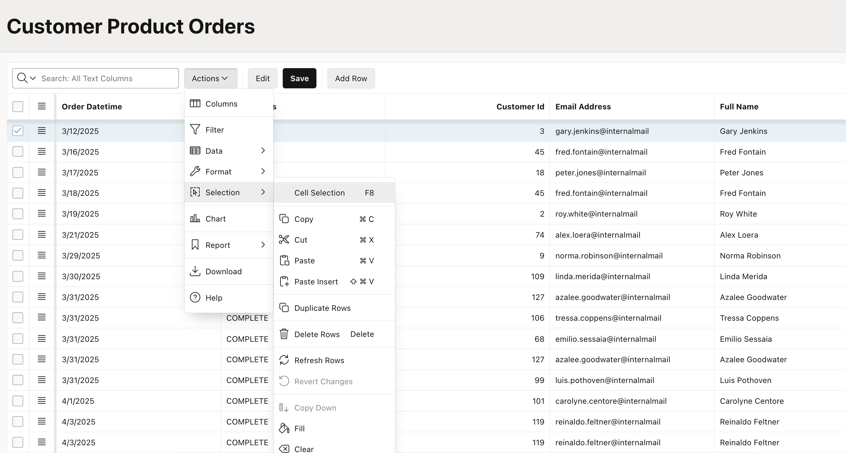
Interactive Grid
Interactive Grid provides rich multi-row viewing and editing with declarative behavior.
It supports item types, cascading LOVs, Dynamic Actions, master-detail patterns, and migration from older tabular forms.

Slide 46
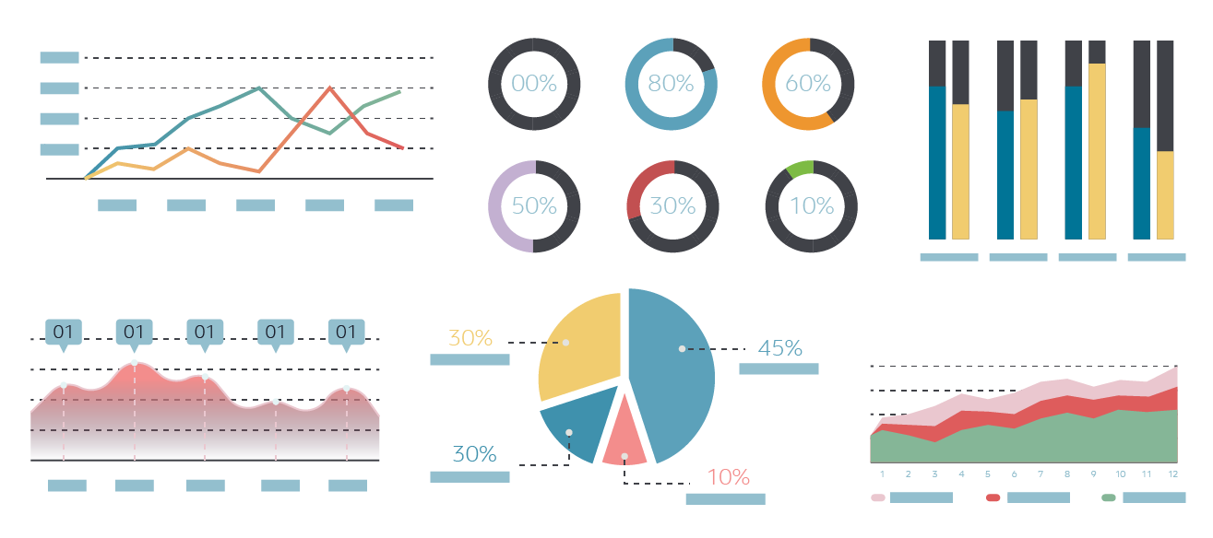
Charting Engine
APEX chart regions turn SQL, REST, and application data into interactive Oracle JET visualizations.
Developers configure chart type, series, labels, links, and responsive behavior declaratively.

Slide 47
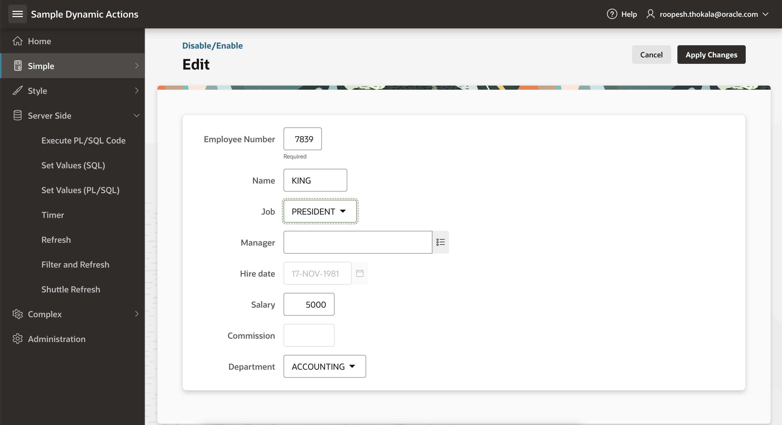
Dynamic Actions
Different views, drag and drop capability
Dynamic Actions let developers add client-side behavior declaratively.
They define when an action fires, which components it affects, and what happens next, reducing the need for custom JavaScript in common interaction patterns.

Slide 48
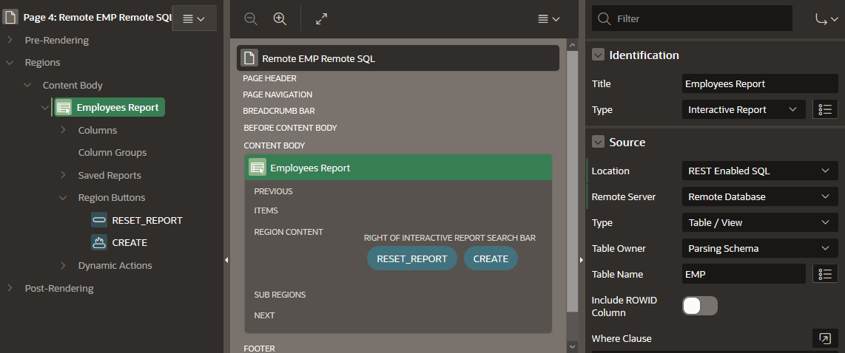
REST-Enabled SQL Support
REST-Enabled SQL lets APEX components work with remote Oracle Databases through ORDS.
Developers manage endpoint and authentication details in Shared Components, then use the remote source for reports, charts, calendars, trees, and processes.

Slide 49
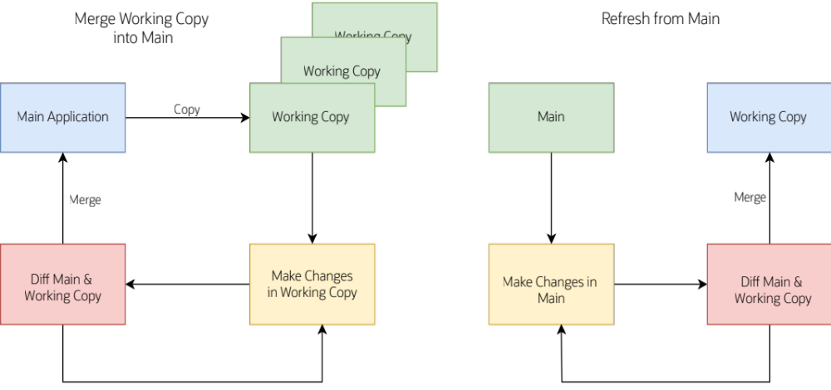
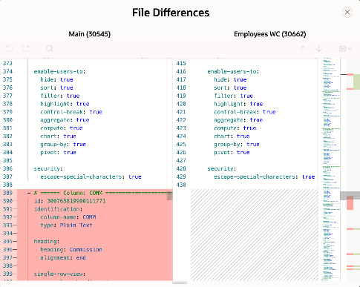
Working Copies
Working Copies let developers isolate changes, compare a copy with the main application, and merge approved updates back.
The model supports parallel work while keeping review and promotion closer to the APEX lifecycle.

Slide 50
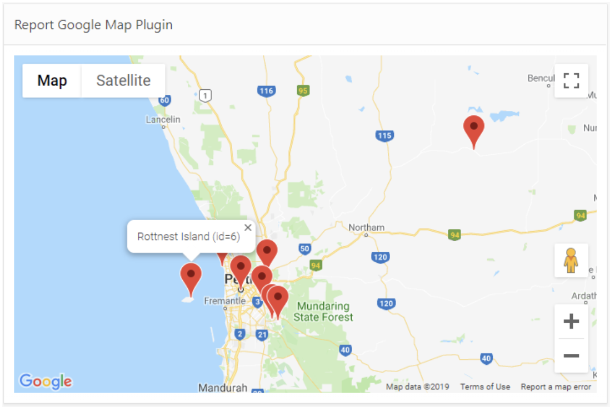
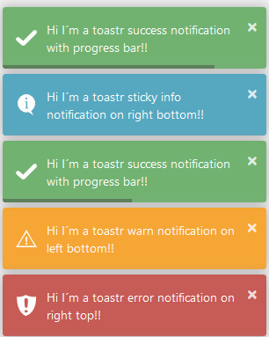
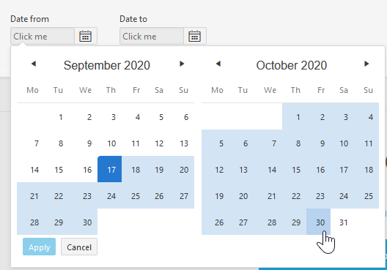
Plug-ins
Plug-ins extend APEX with custom items, regions, processes, Dynamic Actions, and other reusable components when the built-in set is not enough.
apex.world/ords/f?p=100:700

Slide 51
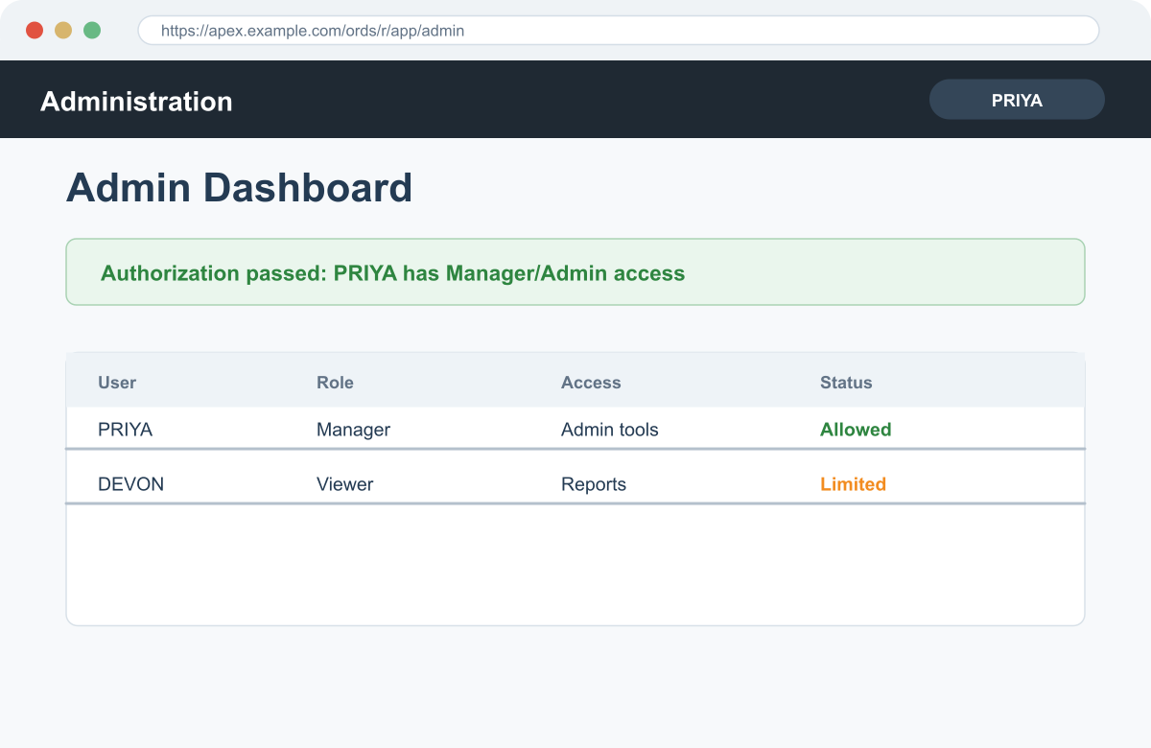
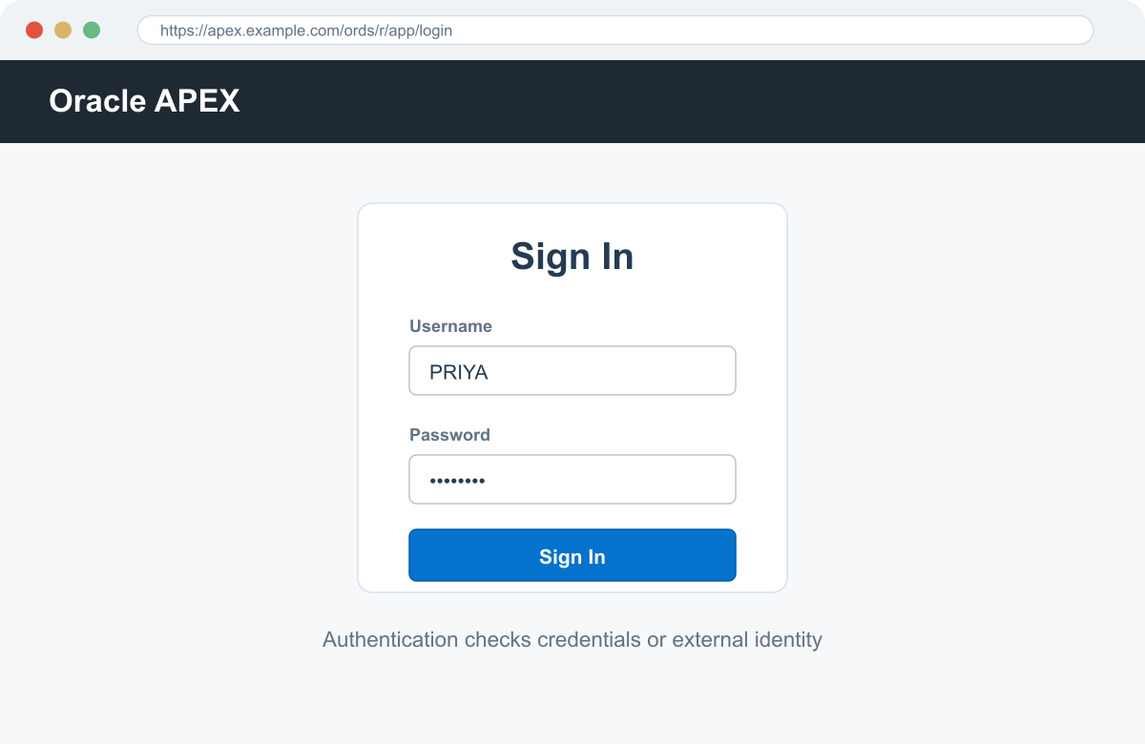
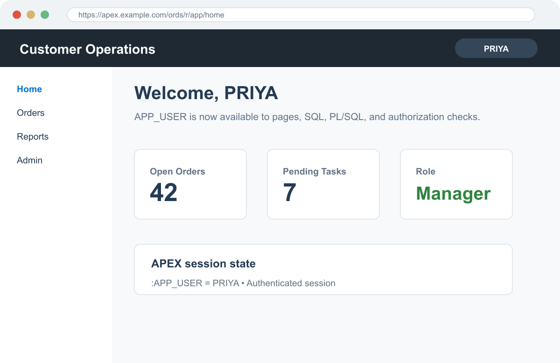
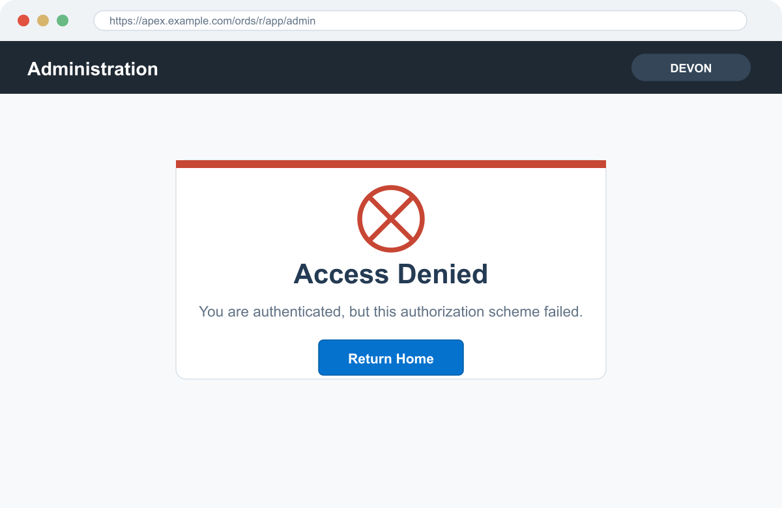
Authentication & Authorization
Authentication creates a known APEX session; authorization uses that identity to provide or restrict access to pages and components.
Who are you?
What may you access?
3. Authorization check
Evaluate APP_USER against role, group, SQL, PL/SQL, item, or preference rules.
4a. Access provided
1. Login page
2. Authenticated home
Authorized user sees protected page or component.
User submits credentials or arrives from SSO.
APEX sets APP_USER and session state.
PASS
FAIL
4b. Access restricted

Slide 52







Authentication & Authorization
User request
Authentication
APEX session
Authorization
Decision
opens app or page
verifies identity
sets APP_USER
evaluates access
allow or deny
Who are you?
What are you allowed to do?
1. Authentication establishes identity
2. Authorization controls access
APEX uses the current authentication scheme to decide whether a request becomes a trusted session.
Authorization schemes then evaluate the identified user against business and security rules.
Credentials or external identity are checked.
Checks can use roles/groups, SQL, PL/SQL, items, or preferences.
If valid, APEX records the user as APP_USER.
Schemes can be attached to apps, pages, controls, and components.
If invalid, the request is stopped before private pages run.
The result is reused or rechecked based on evaluation settings.
Provide access
Restrict access
render page, show region/button, run process, expose permitted data
redirect to login, show access denied, hide component, block execution

Slide 53











Authentication Schemes
User request
Authentication scheme
APEX session
Application access
login or external identity
selected gallery type
APP_USER + session state
pages, data, controls
Native / development
Database + directory
SSO + federation
Extensible
Builder Extension Sign-in
Database Accounts
HTTP Header Variable
Oracle AS SSO
Custom Authentication
Reuses a valid APEX Builder session.
Authenticates with database schema credentials.
External gateway passes user in a header.
Delegates to Oracle Application Server SSO.
PL/SQL-controlled interface and checks; plug-ins can extend authentication behavior.
Oracle APEX Accounts
Workspace-managed APEX users.
LDAP Directory
SAML Sign-In
Social Sign-In
Checks user name and password against LDAP.
Open Door Credentials
Federated sign-in with SAML assertions.
OpenID Connect or OAuth2 providers.
Captures a user name; useful for development.
No Authentication (using DAD)
Adopts the current database user.

Slide 54






Authorization Schemes
Authenticated user
Authorization scheme
Decision
Protected target
APP_USER + session
type + expression
pass or fail
app, page, component, process
Built-in access gates
SQL row checks
PL/SQL + extensible logic
common authorization choices
authorize from database rows
custom business rules
No Authorization Required
Exists SQL Query
PL/SQL Function Returning Boolean
Must Not Be Public User
NOT Exists SQL Query
Authorization type plug-ins
Item state checks
Preference checks
Role / group checks
session item value gates
user preference value gates
APEX roles, groups, DB roles, or custom groups
Item in Expression 1 is NULL
Preference Equals Expression 2
Is In Role or Group
Item in Expression 1 is NOT NULL
Item value Equals Expression 2
Preference Does NOT Equal Expression 2
Is Not In Role or Group
Item value Does NOT Equal Expression 2

Slide 55






Session Management
Browser carries a secure session reference; APEX validates it every request and keeps trusted session state inside Oracle Database
Client tier
Web tier
APEX runtime
Oracle Database
Browser session
Session validation
Session state store
Sends page requests with the APEX session cookie.
1 request + cookie
APEX matches request session ID, cookie, authentication record, and timeout policy.
3 state lookup / update
Page/application item values, user identity, and working set are read and written server-side.
ORDS
Receives HTTPS request and forwards to APEX through pooled DB connections.
2 APEX call
4 APP_SESSION + APP_USER context
Session cookie
APEX session context
APP_SESSION, APP_USER, APP_ID, page, request data, and per-request identity values.
Timeout + cleanup
Browser-held reference to server-side APEX session state.
5 APIs read/write state
Idle/session timeouts, logout, cache clearing, and cleanup reduce stale-session risk.
6 expire / deny / logout
Server-side state
Developer control
APEX stores and retrieves session state in the database; the cookie links the browser to that server-side record.
Use bind variables, V/NV, APEX_UTIL, clear-cache options, and item settings to control state.
Login
Create session ID
Validate each request
Read/write state
Expire or logout

Slide 56






Secure by Default
requests pass through APEX framework security gates before data access; responses are rendered with framework protections and operational feedback
Client tier
Web tier
APEX runtime security gates
Oracle Database
1 Authentication + session
valid user, session cookie, timeout, APP_USER
Database execution
Browser request
SQL / PL/SQL
URL, session cookie, form data, and AJAX enter the app.
request
SQL, PL/SQL, privileges, bind variables, transactions, and application data.
ORDS
2 URL checksums + Session State Protection
Routes web requests to APEX through DB connections.
APEX call
tamper-resistant links and protected item state
3 Authorization gates
✓
app, page, region, button, process, column access
review feedback
APEX Advisor
4 Escaped output by default
Operational checks help find risky settings before release.
safe rendering for displayed data and generated HTML
secure-by-default posture
protected response
Framework first
Tamper and XSS defenses
Explicit developer control
APEX generates runtime pages with built-in protection points.
URL checksums, session state protection, and escaping protect common paths.
Authorization schemes, escaping settings, item protection, and Advisor checks tune behavior.

Slide 57
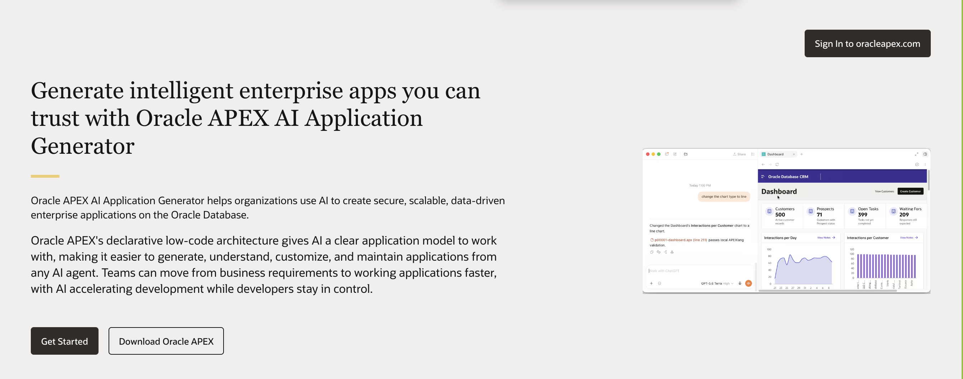
Everything Oracle APEX
oracleapex.com

Slide 58
Thank You

